Slide 1

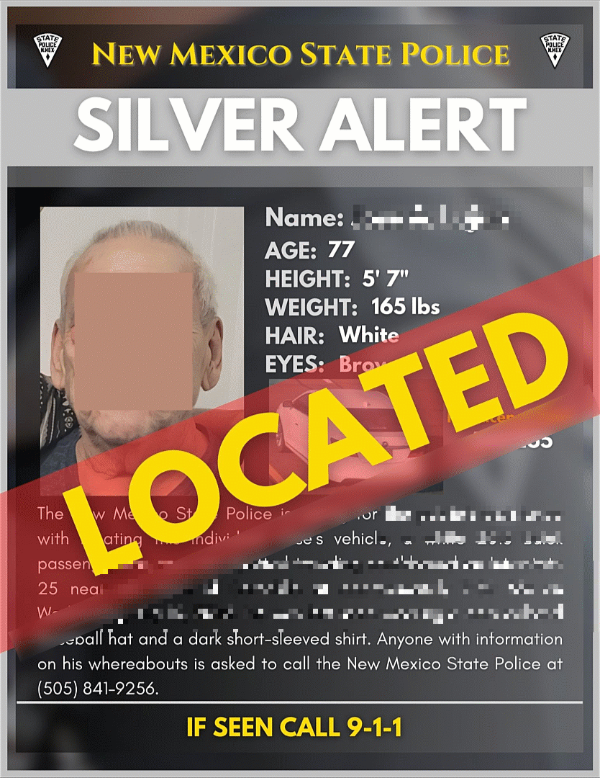

Missing Persons
Missing Persons: Amber Alert, Brittany Alert, Silver Alert, Turquoise Alert, Endangered Persons Advisory
NMLEA Accreditation: NM260015
Notes:
This course will cover Missing Persons, and will include:
Amber Alerts, Brittany Alerts, Silver Alerts, Turquoise Alerts, and Endangered Persons Advisories.

Slide 2
Course Goal
Identify the procedures for filing an AMBER Alert, Brittany Alert, Silver Alert, and Turquoise Alert, to include Endangered Persons.
Notes:
Course Goal
Identify the procedures for filing an AMBER Alert, Brittany Alert, Silver Alert, and Turquoise Alert, to include Endangered Persons.

Slide 3
Objectives
Identify the functions of the NM Missing Persons Clearinghouse
Identify the procedures for conducting a basic missing person investigation
Identify the procedures for notifying appropriate organizations of a missing person
Identify procedures for filing AMBER Alert, Brittany Alert, Silver Alert, Turquoise Alert, and Endangered Persons Advisory
Identify proper forms to fill out for each missing persons category
Notes:
Objectives
Identify the functions of the NM Missing Persons Clearinghouse
Identify the procedures for conducting a basic missing person investigation
Identify the procedures for notifying appropriate organizations of a missing person
Identify procedures for filing AMBER Alert, Brittany Alert, Silver Alert, Turquoise Alert, and Endangered Persons Advisory
Identify proper forms to fill out for each missing persons category

Slide 4

Missing Persons –Statute Definition
"Missing Person" means a person whose whereabouts are unknown to the person's custodian or immediate family member and the circumstances of whose absence indicate that:
(1) the person did not leave the care and control of the custodian or immediate family member voluntarily and the taking of the person was not authorized by law
(2) the person voluntarily left the care and control of the custodian without the custodian's consent and without intent to return
https://nmonesource.com/nmos/nmsa/en/item/4367/index.do#29-15-2
Notes:
By New Mexico Statute, the definition of a Missing Person means a person whose whereabouts are unknown to the person's custodian or immediate family member and the circumstances of whose absence indicate that:
(1) the person did not leave the care and control of the custodian or immediate family member voluntarily and the taking of the person was not authorized by law; or
(2) the person voluntarily left the care and control of the custodian without the custodian's consent and without intent to return;

Slide 5
“Endangered Person"
means a missing person who:
Is in imminent danger of causing harm to the person's self
Is in imminent danger of causing harm to another
Is in imminent danger of being harmed by another or who has been harmed by another
Has been a victim of a crime as provided in the Crimes Against Household Members Act
Is or was protected by an order of protection pursuant to the Family Violence Protection Act
Has Alzheimer's disease, dementia or another degenerative brain disorder or a brain injury
Has a developmental disability and that person's health or safety is at risk
https://nmonesource.com/nmos/nmsa/en/item/4367/index.do#29-15-2
Notes:
By new Mexico statute, an "endangered person" means a missing person who:
(1) is in imminent danger of causing harm to the person's self;
(2) is in imminent danger of causing harm to another;
(3) is in imminent danger of being harmed by another or who has been harmed by another;
(4) has been a victim of a crime as provided in the Crimes Against Household Members Act, or their equivalents in any other jurisdiction;
(5) is or was protected by an order of protection pursuant to the Family Violence Protection Act;
(6) has Alzheimer's disease, dementia or another degenerative brain disorder or a brain injury; or
(7) has a developmental disability and that person's health or safety is at risk;

Slide 6





Missing Persons Information and Reporting Act:
NMSA 29-15
https://nmonesource.com/nmos/nmsa/en/item/4367/index.do#a15
Includes statutes and definitions about:
Missing Persons
The Clearinghouse
Amber Alerts
Brittany Alerts
Silver Alerts
Turquoise Alerts
Endangered Person Advisory
Notes:
Missing Persons Information and Reporting Act:
New Mexico Statute 29 dash 15
Includes statutes and definitions about:
Missing Persons,
The Clearinghouse,
Amber Alerts,
Brittany Alerts,
Silver Alerts,
Turquoise Alerts,
Endangered Person Advisory,

Slide 7

Types of Alerts
Types of Alerts
Turquoise Alert
Skip
Notes:
Instructor Note
Review/PreKnowledge Check Activity
Ask About 4 Alerts, definitions and elements from statute
By clicking on the yellow icons, slides will advance to definition pages, and back button will return to this page.
This slides will be covered again during the lesson
This activity can be skipped by clicking on the skip arrow

Slide 8

Turquoise Alert
Back
A notification relating to a missing person who is an enrolled member or a person eligible for enrollment in a federally or state-recognized Indian nation, tribe or pueblo and the person:
(1) is missing due to involuntary, unexplained or suspicious circumstances
(2) is at risk due to safety or health concerns; or
(3) suffers from a mental or physical disability or substance abuse disorder
https://nmonesource.com/nmos/nmsa/en/item/4367/index.do#29-15-2

Slide 9

Brittany Alert
Back
a notification relating to an endangered person:
(1) who is a missing person; and
(2) about whom there is a clear indication that the person has a developmental disability
(3) and that the person's health or safety is at risk
https://nmonesource.com/nmos/nmsa/en/item/4367/index.do#29-15-2

Slide 10

AMBER Alert
Back
a notification relating to a missing child:
(1) There is evidence that an abduction has occurred
(2) There is reason to believe that the child is in imminent danger of bodily harm or death
(3) The abducted child is aged 17 years or less
https://www.dps.nm.gov/law-enforcement-records-bureau/missing-persons-alerts/amber-alert-information/

Slide 11

Silver Alert
Back
a notification relating to an endangered person:
(1) who is a missing person; and
(2) who is fifty years or older; or
(3) who the reporter believes displays signs or symptoms of Alzheimer's disease or another form of dementia, cognitive decline or impairment, regardless of age
https://nmonesource.com/nmos/nmsa/en/item/4367/index.do#29-15-2

Slide 12

The Missing Persons Information Clearinghouse
Centralize repository of information regarding missing persons for use by all New Mexico law enforcement agencies
Created and maintained by
New Mexico Department of Public Safety’s
Law Enforcement Records Bureau
https://www.dps.nm.gov/law-enforcement-records-bureau/
Missing Persons
Clearinghouse
The preferred way to submit clearing house information is by email along with any photographs or additional information that can be provided.
DPS.MissingPerson@dps.nm.gov
Notes:
The Missing Persons Information Clearinghouse
is a Centralize repository of information regarding missing persons for use by all New Mexico law enforcement agencies
The Missing Persons Information clearinghouse is Created and maintained by
The New Mexico Department of Public Safety’s
Law Enforcement Records Bureau

Slide 13
The Missing Persons Information Clearinghouse
The Clearinghouse:
Is responsible for statewide communication of information relating to missing persons
Provides a centralized file for the exchange of information on missing persons and unidentified human remains within the state
Communicates with the NATIONAL CRIME INFORMATION CENTER (NCIC) for the exchange of information on missing persons suspected of interstate travel
Collects, processes, maintains and disseminate accurate and complete information on missing persons
https://nmonesource.com/nmos/nmsa/en/item/4367/index.do#29-15-3
Notes:
The Missing Persons Information Clearinghouse
Is responsible for statewide communication of information relating to missing persons
It Provides a centralized file for the exchange of information on missing persons and unidentified human remains within the state
The clearinghouse Communicates with the NATIONAL CRIME INFORMATION CENTER (NCIC) for the exchange of information on missing persons suspected of interstate travel
It Collects, processes, maintains and disseminate accurate and complete information on missing persons

Slide 14
The Missing Persons Information Clearinghouse
The Clearinghouse:
Provides a statewide toll-free telephone line for the reporting of missing persons and for receiving information on missing persons
Compiles statistics relating to the incidence of missing persons within the state
Provides training and technical assistance to law enforcement agencies and social services agencies pertaining to missing persons
https://nmonesource.com/nmos/nmsa/en/item/4367/index.do#29-15-3
Notes:
The Missing Persons Information Clearinghouse also
Provides a statewide toll-free telephone line for the reporting of missing persons and for receiving information on missing persons
And Compiles statistics relating to the incidence of missing persons within the state
The clearinghouse Provides training and technical assistance to law enforcement agencies and social services agencies pertaining to missing persons

Slide 15

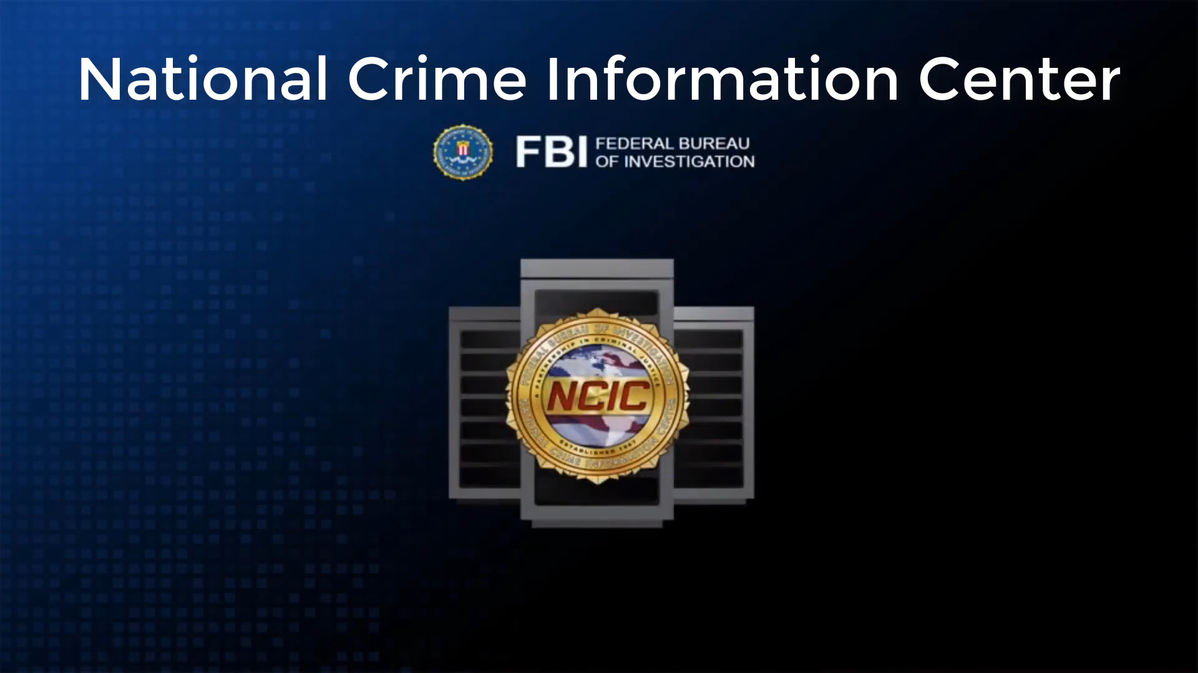
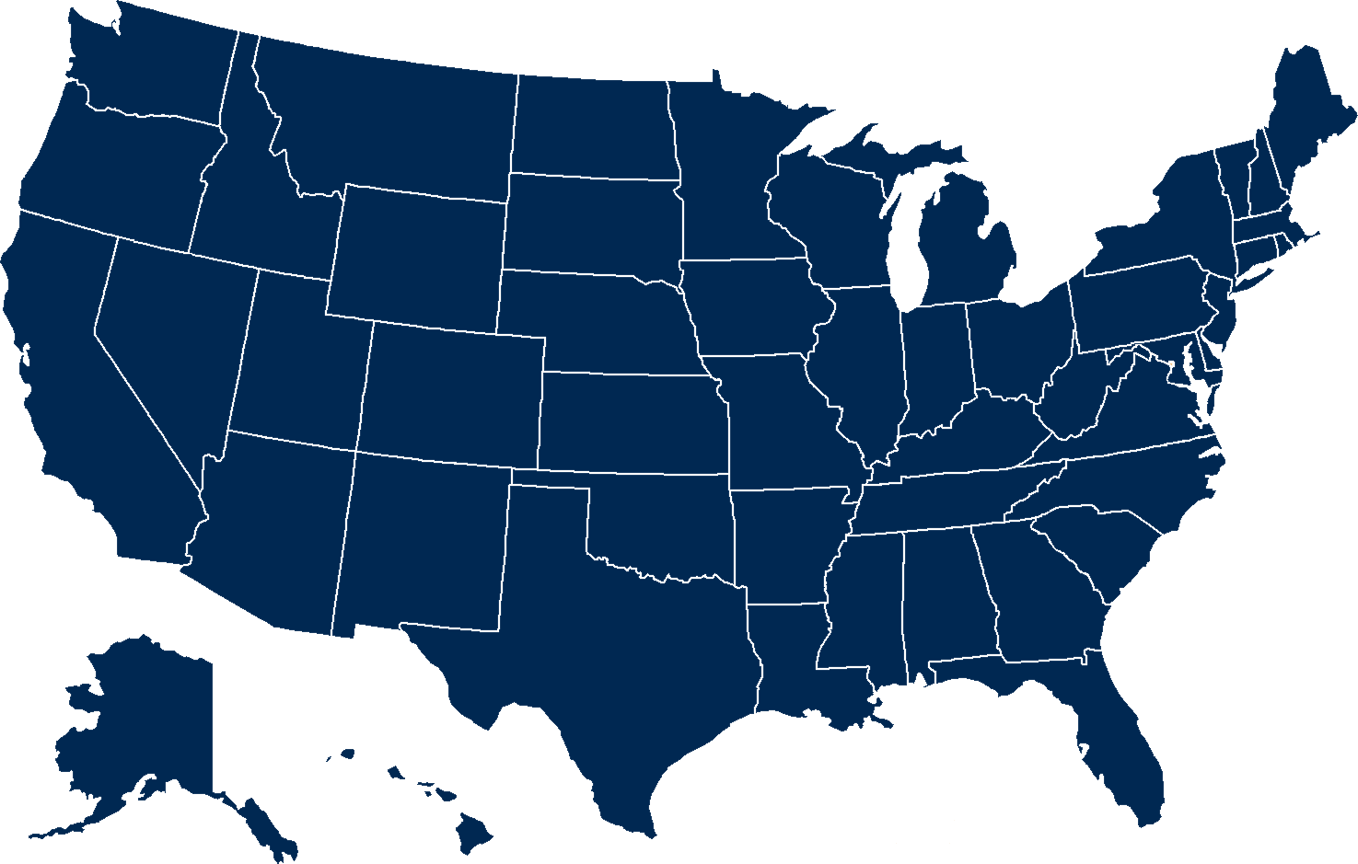

Slide 16
29-15-7 NMSA Missing Persons – Law Enforcement Requirements
Receiving a Report of a Missing Person
Law Enforcement SHALL accept without delay/exception a report of a missing person.
Law enforcement SHALL, within 2 hours (NICI requirement)
1. Start an investigation
2. Determine if the person is an Endangered Person and notify DPS.
3. Provide all the information to the Clearinghouse.
4. Enter the name of the missing individual into:
  The Clearinghouse
  NATIONAL CRIME INFORMATION CENTER (NCIC)
5. Obtain follow-up information as soon as possible and enter necessary information into NCIC.
The 2 hours begins when dispatch receives the initial call
For Unidentified Remains
Enter detailed information regarding unidentified remains into NCIC
The Clearinghouse may already have the information from NCIC
https://nmonesource.com/nmos/nmsa/en/item/4367/index.do#29-15-7
Notes:
New Mexico Statute 29 dash 15 dash 7
Law Enforcement Requirements
Receiving a Report of a Missing Person
Law Enforcement SHALL accept without delay/exception a report of missing person.
Law enforcement SHALL, within 2 hours
1. Start an investigation…
2. Determine if the person is an Endangered Person and notify the New Mexico Department of Public Safety.
3. Provide all the information to the new Mexico missing persons information Clearinghouse.
4. Enter name of the missing individual into:
The new Mexico missing persons information Clearinghouse,
And the NATIONAL CRIME INFORMATION CENTER.
5. Obtain follow-up information as soon as possible and enter necessary information into National Crime Information Center.
Please Note: The 2 hours begins when dispatch receives the initial call

Slide 17



We need current pictures of the missing person.
Notes:
Pictures curtesy Barb Schalkofski

Slide 18
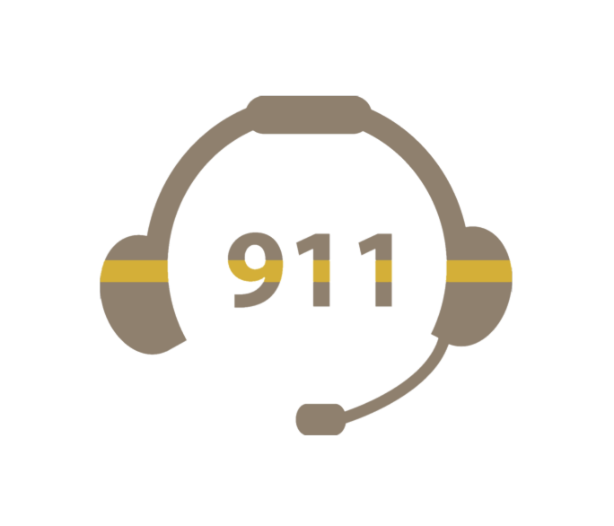
Missing Person’s Investigation Recommended Procedures
Telecommunication Personnel
Telecommunications personnel who receive incoming reports concerning missing/endangered persons shall immediately, or as soon as practical and within the 2-hour federal requirements:
Contact an officer/supervisor or criminal agent/supervisor to inform them of the incident
Obtain sufficient information from the reporting party to broadcast a “Be on the Lookout” (BOLO) alerting other officers about the circumstances of the adult/child disappearance.
Notes:
Missing Person’s Investigation Recommended Procedures
Telecommunication Personnel
Telecommunications personnel who receive incoming reports concerning missing/endangered persons shall immediately, or as soon as practical:
Contact an officer/supervisor or criminal agent/supervisor to inform them of the incident
Obtain sufficient information from the reporting party to broadcast a “Be on the Lookout” (BOLO) alerting other officers about the circumstances of the adult/child disappearance.

Slide 19
Missing Person’s Investigation Recommended Procedures
Law Enforcement Personnel:
Immediately begin an investigation:
1. Obtain identification, clothing description, last known location, distinguishing marks other pertinent information from the reporting party to broadcast a “Be on the Lookout” BOLO alerting other officers about the circumstances of the adult/child disappearance.
2. Provide identification of missing person and summary of circumstances to:
State Police
Neighboring Agencies
Stranger to stranger abduction is suspected, the FBI
FBI Duty Agent – (505) 889-1300
https://www.fbi.gov/contact-us/field-offices/albuquerque
Notes:
Missing Person’s Investigation Recommended Procedures
Law Enforcement Personnel:
Immediately begin an investigation:
1. Obtain identification, clothing description, last known location, distinguishing marks other pertinent information from the reporting party to broadcast a “Be on the Lookout” BOLO alerting other officers about the circumstances of the adult/child disappearance.
2. Provide identification of missing person and summary of circumstances to:
the State Police
the Neighboring Agencies
if a Stranger to stranger abduction is suspected, the FBI

Slide 20
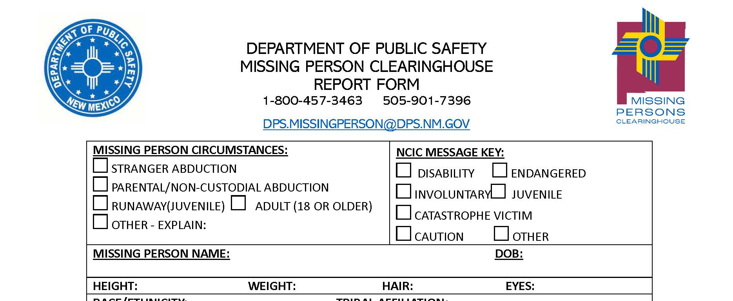
Missing Person’s Investigation Recommended Procedures
Law Enforcement Personnel:
3. Collect all available information to complete Missing Persons Clearinghouse Report Form (MPCH form)
4.Treat areas of interest as potential crime scenes
Notes:
Missing Person’s Investigation Recommended Procedures
Law Enforcement Personnel:
3. Collect all available information to complete Missing Persons Clearinghouse Report Form (MPCH form)
4.Treat areas of interest as potential crime scenes

Slide 21
Missing Person’s Investigation Recommended Procedures
Law Enforcement Personnel:
5.Evaluate and determine if additional resources are needed such as supervisor, crime scene team, etc.
If there is a possibility or potential Alert (AMBER, Brittany, Silver, or Turquoise) that needs to be issued:
  Contact the New Mexico State Police and request to speak to their “On Call” PIO (Public Information Officer)
  Their PIO will run through the requirements and checklists. If it qualifies, they will issue the alert statewide.
  It will still be the investigative agency’s responsibility to ensure that the person is entered into the National Crime Information Center as a missing person through their dispatch center.
Notes:
Missing Person’s Investigation Recommended Procedures
Law Enforcement Personnel:
5.Evaluate and determine if additional resources are needed such as supervisor, crime scene team, etc.
If there is a possibility or potential Alert (AMBER, Brittany, Silver, or Turquoise) that ineeds to be issued:
Contact the NMSP and request to speak to their “On Call” PIO (Public Information Officer)
Their PIO will run through the requirements and checklists. If it qualifies, they will issue the alert statewide.
It will still be the investigative agency’s responsibility to ensure that the person gets entered into NCIC as a missing person through their dispatch center.

Slide 22
Missing Person’s Investigation Recommended Procedures
Law Enforcement Personnel:
ANY agency can issue a graphic/flyer to be sent out for
  Missing Endangered Alert
  Brittany Alert
  Turquoise Alert
  Silver Alert
Agencies must contact NMSP PIO for
An Amber Alert
To send out the Silver Alert through mobile devices
For Turquoise alerts that meet the imminent danger of death and/or great bodily harm criteria agencies must contact NMSP PIO to send out that alert through mobile devices
Source Lt Philip Vargas, NMSP PIO
Notes:
ANY agency can issue a graphic flyer to be sent out for:
a Missing Endangered Alert;
a Brittany Alert;
a Turquoise Alert;
or a Silver Alert.
In addition, Agencies must contact the New Mexico State Police Public Information Officer for:
An Amber Alert.
To send out the Silver Alert through mobile devices.
and;
For Turquoise alerts that meet the imminent danger of death and/or great bodily harm criteria, agencies must contact the New Mexico State Police Public Information Officer to send out that alert through mobile devices.
Contact state police for any questions or clarifications

Slide 23
Missing Person’s Investigation Recommended Procedures
Law Enforcement Personnel:
6. Complete and notify appropriate personnel for entry of information into the National Crime Information Center (NCIC) & ensure the Missing Persons Clearinghouse Report Form (MPCH form) is sent to the New Mexico Department of Public Safety
7. Refer to the Missing Persons Investigative Checklist to ensure necessary criteria is met
8. In the event it is determined that the person is missing under suspicious circumstances or endangered, complete the Endangered Person Advisory form and send it to DPS Clearinghouse (MPCH)
Notes:
6. Complete and notify appropriate personal for entry of information into National Crime Information Center (NCIC) & ensure Missing Persons Clearinghouse Report Form (MPCH form) sent to New Mexico Department of Public Safety….
7. Refer to Missing Persons Investigative Checklist to ensure necessary criteria is met…
8. In the event it is determined that person is missing under suspicious circumstances or endangered, complete Endangered Person Advisory form and send to DPS Clearinghouse (MPCH)…

Slide 24
Missing Person’s Investigation Recommended Procedures
Law Enforcement Personnel:
For Endangered Person Advisory, Consider:
  Missing person’s age
  Health
  Mental disability
  Physical disability
  Environment/weather conditions
  If they are in the company of a dangerous person
  Or other factors that place the person in imminent peril when determining “endangered”
Any information available that may be beneficial for the public to assist in locating the missing person
https://www.amberadvocate.org/wp-content/uploads/2021/06/NCMEC_FIRST_RESPONDER_CHECKLIST.pdf
Notes:
For Endangered Person Advisory, Consider:
Missing person’s age;
Health;
Mental disability;
Physical disability;
Environmental and weather conditions;
If they are in the company of a dangerous person;
Or other factors that place the person in imminent peril when determining “endangered”
Also consider Any information available that may be beneficial for the public to assist in locating the missing person

Slide 25
Missing Person’s Investigation Recommended Procedures
Law Enforcement Personnel:
9. Immediately enter the name of the missing person into the National Crime Information Center (NCIC) and the NM Missing Persons Clearinghouse (MPCH)
10. Contact the State Police to coordinate the issuance of an Endangered Persons Advisory
11. Evaluate whether the information warrants a search of a given area
12. Contact the State Police to coordinate large scale searches
13. Upon receiving a report of a missing/runaway child, within 24 hours notify the State Registrar and submit a Birth Certificate Flag Request form to NM Vital records
Notes:
9. Immediately enter the name of the missing person into the National Crime Information Center (NCIC) and New Mexico Missing Persons Clearinghouse (MPCH)
10. Contact the State Police to coordinate the issuance of an Endangered Persons Advisory
11. Evaluate whether the information warrants a search of a given area
12. Contact the State Police to coordinate large scale searches
13. Upon receiving a report of a missing or runaway child, within 24 hours, notify the State Registrar, and submit a Birth Certificate Flag Request form to New Mexico Vital records

Slide 26
Missing Person’s Investigation Recommended Procedures
Law Enforcement Personnel:
14.Provide the Dental Record Release form to parent, guardian, or immediate family member to sign. Officers must request dental records no later than 2 weeks after the initial call.
15.Maintain contact with family and keep them informed
16.Update National Crime Information Center (NCIC) and Missing Persons Clearinghouse (MPCH) with any new information ASAP within 48 hours
Notes:
14.Provide the Dental Record Release form to parent, guardian, or immediate family member to sign. Officers must request dental records no later than 2 weeks after the initial call.
15.Maintain contact with family and keep them informed
16.Update the National Crime Information Center and the Missing Persons Clearinghouse with any new information As Soon As Possible within 48 hours

Slide 27

Immediately After a Missing Person/Child is Located the Investigating Officer/Agent Shall:
Verify that the missing person has been found
They came home safe…
Notes:
Immediately After a Missing Person/Child is Located the Investigating Officer/Agent Shall:
Verify that the missing person has been found
Instructor
Why is verification important during a missing person investigation?

Slide 28
Immediately After a Missing Person/Child is Located the Investigating Officer/Agent Shall:
Request the person’s entry be cleared from National Crime Information Center (NCIC).
Within twenty-four (24) hours of receiving information a missing child was located, complete Missing Child Notification Birth Certificate Flag Cancellation Request Form and fax it to New Mexico Vital Records and Health Statistics and notify the State Registrar in writing that the missing child has been located.
Consider interviewing the child/person to determine if other criminal activity may have been committed or permitted, such as child abuse, adult/elderly abuse, neglect, etc.
Notes:
Immediately After a Missing Person/Child is Located the Investigating Officer/Agent Shall:
Request the person’s entry be cleared from National Crime Information Center (NCIC).
Within twenty-four (24) hours of receiving information a missing child was located, complete Missing Child Notification Birth Certificate Flag Cancellation Request Form and fax it to New Mexico Vital Records and Health Statistics and notify the State Registrar in writing that the missing child has been located.
Consider interviewing the child/person to determine if other criminal activity may have been committed or permitted, such as child abuse, adult/elderly abuse, neglect, etc.

Slide 29
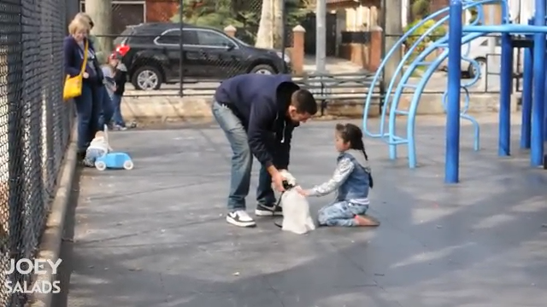
Notes:
Joey Salads CHILD ABDUCTION (Social Experiment)
https://www.youtube.com/watch?v=gGIDHrYKJ2s

Slide 30
AMBER Alert
Notes:
In this section, we will cover amber alerts

Slide 31
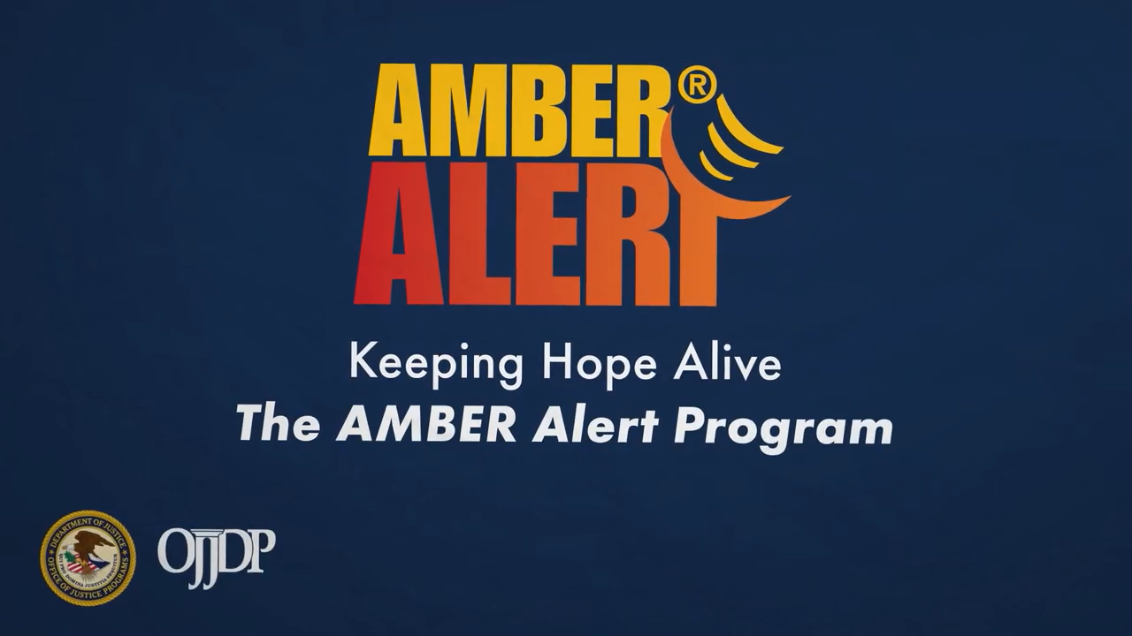
Video:
The AMBER Alert Program

Slide 32
AMBER Alert
a notification relating to a missing child:
(1) There is evidence that an abduction has occurred
(2) There is reason to believe that the child is in imminent danger of bodily harm or death
(3) The abducted child is aged 17 years or less
https://www.dps.nm.gov/law-enforcement-records-bureau/missing-persons-alerts/amber-alert-information/
Notes:
An Amber Alert is
a notification relating to missing child:
(1) There is evidence that an abduction has occurred
(2) There is reason to believe that the child is in imminent danger of bodily harm or death
(3) The abducted child is aged 17 years or less
State Police may declare an AMBER Alert when there is reason to believe all of the following:
A child under the age of eighteen (18) has been abducted
The child is in imminent danger of serious bodily harm or death
There is specific information available about the child or the child's abductor that may assist in an expedient and successful end to the abduction

Slide 33

AMBER ALERTS PROCEDURES
Law Enforcement Agencies investigating child abduction, may request the issuance of an AMBER Alert through State Police
The Law Enforcement agency requesting an AMBER Alert will be referred to the State Police Public Information Officer or Headquarters Duty Officer. The State Police (the Authorized Requestor) will determine if the criteria for an AMBER Alert are met and if the request is valid.
Notes:
AMBER ALERTS PROCEDURES
Law Enforcement Agencies investigating child abduction, may request the issuance of an AMBER Alert through State Police
The Law Enforcement agency requesting an AMBER Alert will be referred to the State Police Public Information Officer or Headquarters Duty Officer. The Authorized Requestor (State Police) will determine if the criteria for an AMBER Alert are met and if the request is valid.

Slide 34



AMBER ALERTS PROCEDURES
Immediately request entry of information into the National Crime Information Center (NCIC) and the Missing Persons Information Clearinghouse (MPCH)
AMBER Alerts are sent out region wide following DPS protocols.
Notes:
AMBER ALERTS PROCEDURES
Immediately request entry of information National Crime Information Center (NCIC) and the Missing Persons Information Clearinghouse (MPCH)
AMBER Alerts are sent out region wide following DPS protocol.

Slide 35
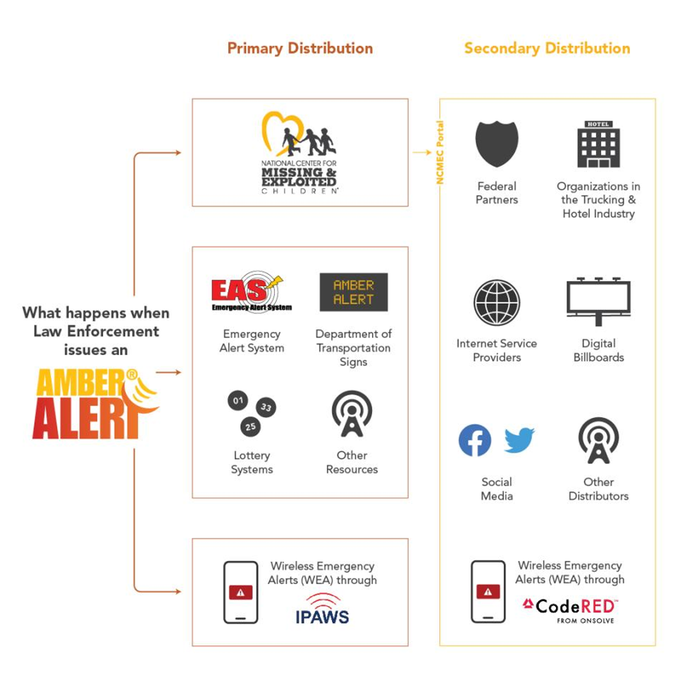
During an AMBER Alert
https://amberalert.ojp.gov/about/amber-alert-flowchart

Slide 36
AMBER ALERTS DEACTIVATION PROCEDURES
If the child has been located and confirmed safe, immediately notify the State Police
Only the State Police (the Authorized Requestor) may determine the validity of a request to terminate an active AMBER Alert
Immediately request removal from the National Crime Information Center (NCIC) and send information to the Missing Persons Information Clearinghouse (MPCH)
Notes:
AMBER ALERTS DEACTIVATION PROCEDURES
If the child has been located and confirmed safe, immediately notify the authorized requestor
Only the Authorized Requestor (State Police) may determine the validity of a request to terminate an active AMBER Alert
Immediately request removal from National Crime Information Center (NCIC) and send information the Missing Persons Information Clearinghouse (MPCH)

Slide 37
Silver Alert
Notes:
In this section, we will cover silver alerts.

Slide 38
Silver Alert
IMPORTANT- A diagnosis is preferred but is not required.
a notification relating to an endangered person:
(1) who is a missing person; and
(2) who is fifty years or older; or
(3) who the reporter believes displays signs or symptoms of Alzheimer's disease or another form of dementia, cognitive decline or impairment, regardless of age
https://nmonesource.com/nmos/nmsa/en/item/4367/index.do#29-15-2
Notes:
The requirements for a silver alert activation are:
a notification relating to an endangered person:
(1) who is a missing person; and
(2) who is fifty years or older; or
(3) who the reporter believes displays signs or symptoms of Alzheimer's disease or another form of dementia, cognitive decline or impairment, regardless of age

Slide 39


Slide 40
Silver Alert Procedures
Immediately request entry of information into the National Crime Information Center (NCIC) and the Missing Persons Information Clearinghouse (MPCH)
Law Enforcement Agencies investigating an endangered missing person report, may request the issuance of a Silver Alert through State Police
Notes:
Silver Alert Procedures
Immediately request entry of information National Crime Information Center (NCIC) and the Missing Persons Information Clearinghouse (MPCH)
Law Enforcement Agencies investigating an endangered missing person report, may request the issuance of a Silver Alert through State Police

Slide 41
Silver Alert Procedures
The Law Enforcement agency requesting a Silver Alert will be referred to the State Police Public Information Officer or Headquarters Duty Officer.
The State Police (the Authorized Requestor) will determine if the criteria for a Silver Alert are met and if the request is valid.
Silver Alerts are sent out region wide following DPS protocol
Notes:
Silver Alert Procedures
The Law Enforcement agency requesting a Silver Alert will be referred to the State Police Public Information Officer or Headquarters Duty Officer. The Authorized Requestor (State Police) will determine if the criteria for a Silver Alert are met and if the request is valid.
Silver Alerts are sent out region wide following DPS protocol

Slide 42

Silver Alert Deactivation Procedures
When the endangered person has been located and confirmed safe, immediately notify the State Police
Only the State Police (the Authorized Requestor) may determine the validity of a request to terminate an active Silver Alert
Immediately request removal from
National Crime Information Center
(NCIC) and send information to the
Missing Persons Information
Clearinghouse (MPCH)
Notes:
Silver Alert Deactivation Procedures
When the endangered person has been located and confirmed safe, immediately notify the authorized requestor
Only the Authorized Requestor (State Police) may determine the validity of a request to terminate an active Silver Alert
Immediately request removal from
National Crime Information Center
(NCIC) and send information the
Missing Persons Information
Clearinghouse (MPCH)

Slide 43


Brittany Alerts
Notes:
In this section, we will cover brittany alerts.

Slide 44
Brittany Alert
a notification relating to an endangered person:
(1) who is a missing person; and
(2) about whom there is a clear indication that the person has a developmental disability as defined in Subsection A of Section 28-16A-6 NMSA 1978
(3) and that the person's health or safety is at risk
https://nmonesource.com/nmos/nmsa/en/item/4367/index.do#29-15-2
Notes:
Brittany Alert
a notification relating to an endangered person:
(1) who is a missing person; and
(2) about whom there is a clear indication that the person has a developmental disability as defined in Subsection A of new Mexico statute 28 dash 16A dash 6
(3) and that the person's health or safety is at risk

Slide 45

What is IDD?

Slide 46
Definition Developmental Disability
By New Mexico Statute, a "developmental disability" means:
  a severe chronic mental impairment, including impairments that are result from trauma to the brain,
  or physical impairment,
  or combination of mental and physical impairments
Developmental Disabilities manifest before the person reaches the age of 22, are expected to continue indefinitely in the person lifetime, and may require lifelong assistance or caregiving
https://nmonesource.com/nmos/nmsa/en/item/4365/index.do#28-16A-6
Notes:
By New Mexico Statute,
A "developmental disability" means a severe chronic mental impairment,, including the result from trauma to the brain, or physical impairment, or combination of mental and physical impairments
Developmental Disabilities manifest before the person reaches the age of 22, are expected to continue indefinitely in the person lifetime, and may require lifelong assistance or caregiving

Slide 47
Definition Developmental Disability
By New Mexico Statute,
Developmental Disabilities result in substantial functional limitations in 3 or more of the following areas of major life activity:
Self-care
Ability to understand and/or produce language
Learning
Mobility
Self-direction
Capacity for independent living
Economic self-sufficiency
https://nmonesource.com/nmos/nmsa/en/item/4365/index.do#28-16A-6
Notes:
By New Mexico Statute,
Developmental Disabilities results in substantial functional limitations in three or more of the following areas of major life activity:
self-care
Ability to understand and/or produce language
learning
mobility
self-direction
capacity for independent living
economic self-sufficiency

Slide 48
Brittany Alerts Procedures
Immediately request entry of information into the National Crime Information Center (NCIC) and the Missing Persons Information Clearinghouse (MPCH)
Law Enforcement Agencies investigating an endangered missing person report, may request the issuance of a Brittany Alert through State Police
Notes:
Brittany Alerts Procedures
Immediately request entry of information into the National Crime Information Center and the Missing Persons Information Clearinghouse
Law Enforcement Agencies investigating an endangered missing person report, may request the issuance of a Brittany Alert through State Police

Slide 49
Brittany Alerts Procedures
The Law Enforcement agency requesting a Brittany Alert will be referred to the State Police Public Information Officer or Headquarters Duty Officer. The State Police (the Authorized Requestor) will determine if the criteria for a Brittany Alert are met and if the request is valid.
Brittany Alerts are sent out region wide following DPS protocol
Notes:
Brittany Alerts Procedures
The Law Enforcement agency requesting a Brittany Alert will be referred to the State Police Public Information Officer or Headquarters Duty Officer. The Authorized Requestor (State Police) will determine if the criteria for a Brittany Alert are met and if the request is valid.
Brittany Alerts are sent out region wide following DPS protocol

Slide 50
Brittany Alerts
DEACTIVATION PROCEDURES
When the endangered person has been located and confirmed safe, immediately notify the State Police
Only the State Police (the Authorized Requestor) may determine the validity of a request to terminate an active Brittany Alert
Immediately request removal from National Crime Information Center (NCIC) and send information the
Missing Persons Information Clearinghouse (MPCH)
Notes:
Brittany Alerts
DEACTIVATION PROCEDURES
When the endangered person has been located and confirmed safe, immediately notify the Authorized Requestor
Only the Authorized Requestor (State Police) may determine the validity of a request to terminate an active Brittany Alert
Immediately request removal from National Crime Information Center (NCIC) and send information the
Missing Persons Information Clearinghouse (MPCH)

Slide 51
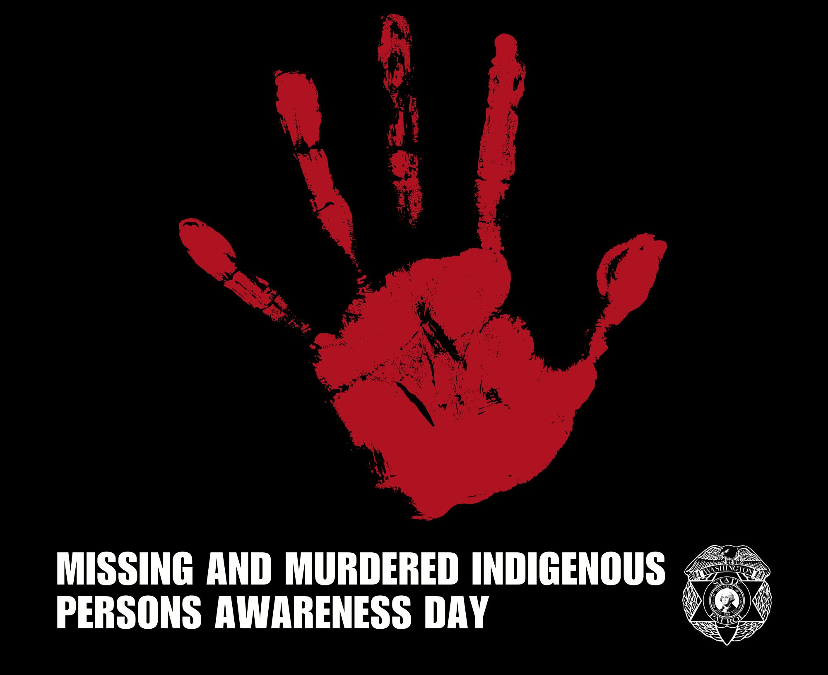
Turquoise Alert
Notes:
In this section, we will cover turquoise alerts.

Slide 52
Turquoise Alert
A notification relating to a missing person who is an enrolled member or a person eligible for enrollment in a federally or state-recognized Indian nation, tribe or pueblo and the person:
(1) is missing due to involuntary, unexplained or suspicious circumstances
(2) is at risk due to safety or health concerns; or
(3) suffers from a mental or physical disability or substance abuse disorder
https://nmonesource.com/nmos/nmsa/en/item/4367/index.do#29-15-2
Notes:
Turquoise Alert
A notification relating to a missing person who is an enrolled member or a person eligible for enrollment in a federally or state-recognized Indian nation, tribe or pueblo and the person:
(1) is missing due to involuntary, unexplained or suspicious circumstances
(2) is at risk due to safety or health concerns; or
(3) suffers from a mental or physical disability or substance abuse disorder

Slide 53
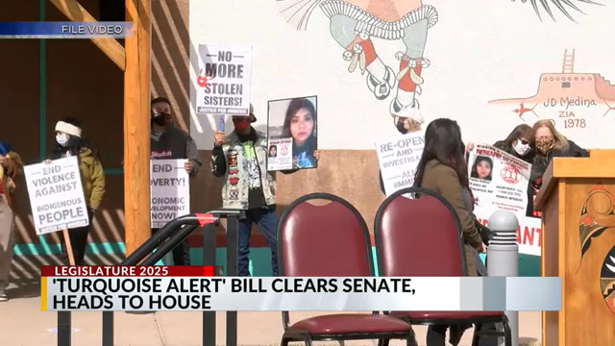

Video: Turquoise Alert

Slide 54

Turquois Alert
Turquoise Alert
https://nmonesource.com/nmos/nmsa/en/item/4367/index.do#29-15-2
https://nmonesource.com/nmos/nmsa/en/item/4367/index.do#29-15-3.5
The Department of Public Safety or the lead investigating law enforcement agency shall issue a Turquoise Alert if, after review and investigation of a missing person report of a person subject to the alert, the department of public safety or the lead investigating law enforcement agency makes an independent determination that the missing person is a person subject to the alert.
https://nmonesource.com/nmos/nmsa/en/item/4367/index.do#29-15-3.5
Notes:
Turquoise Alert
The Department of Public Safety or the lead investigating law enforcement agency shall issue a Turquoise Alert if, after review and investigation of a missing person report of a person subject to the alert, the department of public safety or the lead investigating law enforcement agency makes an independent determination that the missing person is a person subject to the alert.

Slide 55
Turquoise Alert Deactivation
Once a Turquoise Alert has been declared, only the Department of Public Safety or the lead investigating law enforcement agency may terminate the Turquoise Alert
https://nmonesource.com/nmos/nmsa/en/item/4367/index.do#29-15-3.5
Notes:
Turquoise Alert
Once a Turquoise Alert has been declared, only the Department of Public Safety or the lead investigating law enforcement agency may terminate the Turquoise Alert

Slide 56
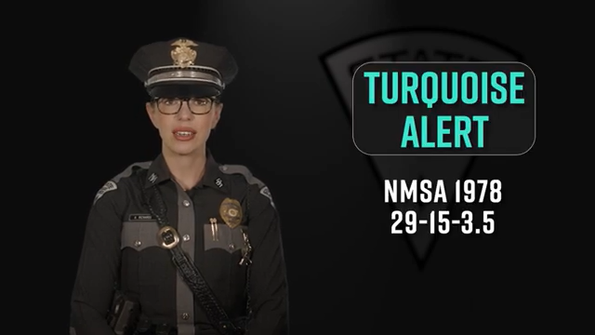

Slide 57

Endangered Person
Advisory
Notes:
In this section, we will cover endangered person advisories.

Slide 58
Endangered Person Advisory
An Endangered Person Advisory includes Department of Public Safety (DPS) procedures utilized for disseminating, as rapidly as possible, information about an endangered person.
An Endangered Person Advisory will be issued in the event a person is determined to be missing under unexplained or suspicious circumstances or deemed to be an endangered person/child.
https://nmonesource.com/nmos/nmsa/en/item/4367/index.do#29-15-3.1
Notes:
Endangered Person Advisory
An Endangered Person Advisory includes Department of Public Safety procedures utilized for disseminating, as rapidly as possible, information about an endangered person.
An Endangered Person Advisory will be issued in the event a person is determined to be missing under unexplained or suspicious circumstances or deemed to be an endangered person or child.

Slide 59
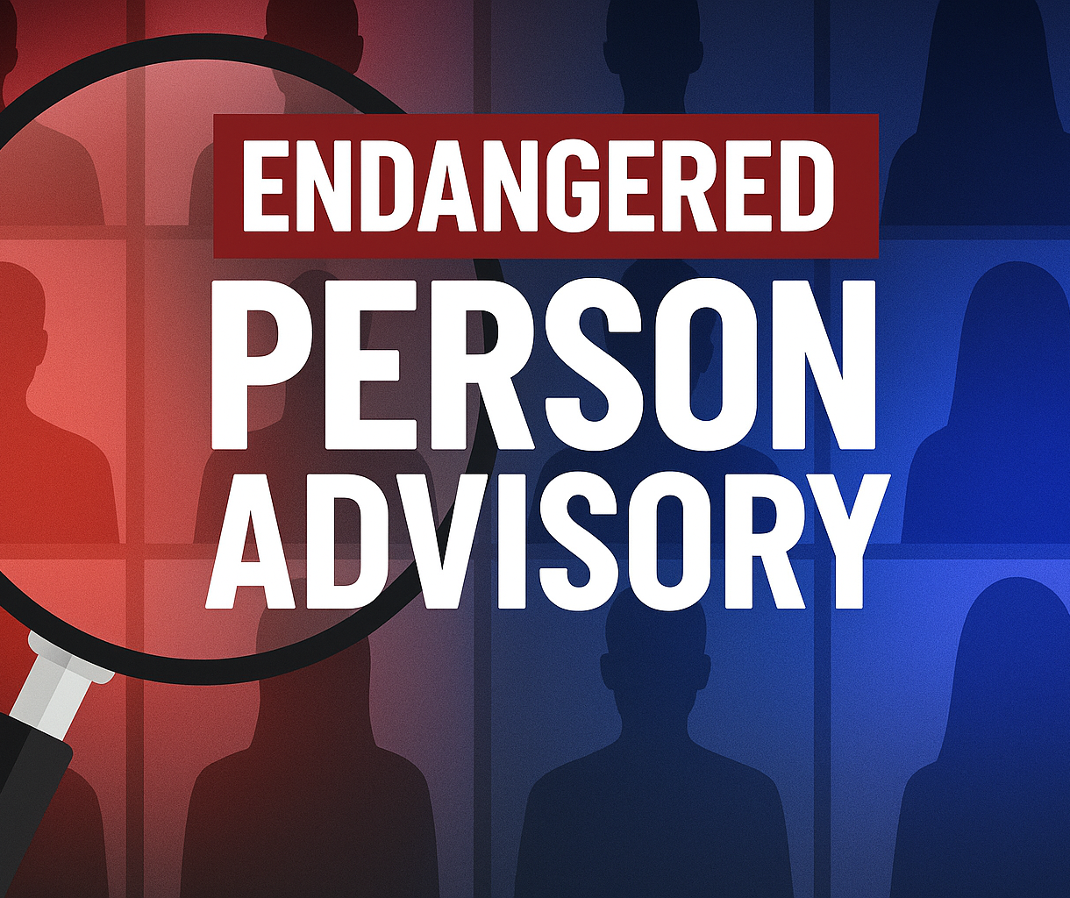
Endangered Person Advisory
Endangered or “at risk” persons are those who meet or when one or more of the following exist:
Out of the safety zone for his/her age, developmental stage, or mental and physical condition.
Diminished mental capacity or suicidal tendencies
Drug dependent requires life or health sustaining medications
A missing child thirteen (13) years of age or younger
Endangered or “at risk” persons are those who meet or when one or more of the following exist:
a. A missing child thirteen (13) years of age or younger (National Child Search Assistance Act).
b. Out of the safety zone for his/her age, developmental stage, or mental and physical condition.
c. Diminished mental capacity or suicidal tendencies.
d. Drug dependent requires life or health sustaining medications.
e. A potential victim of foul play or sexual exploitation.
f. In a life-threatening situation.
g. Absent from home for more than twenty-four (24) hours before being reported to law enforcement as missing.
h. Believed to be with others who could endanger his/her welfare.
i. Is absent under circumstances inconsistent with established patterns of behavior.
https://nmonesource.com/nmos/nmsa/en/item/4367/index.do#29-15-3.1
Notes:
Endangered or “at risk” persons are those who meet or when one or more of the following exist:
A missing child thirteen (13) years of age or younger.
Out of the safety zone for his/her age, developmental stage, or mental and physical condition.
Diminished mental capacity or suicidal tendencies.
Drug dependent requires life or health sustaining medications.

Slide 60
Endangered Person Advisory Pt 2
Endangered or “at risk” persons are those who meet or when one or more of the following exist (cont.):
Absent from home for more than twenty-four (24) hours before being reported to law enforcement as missing.
Believed to be with others who could endanger his/her welfare
A potential victim of foul play or sexual exploitation
Is absent under circumstances inconsistent with established patterns of behavior.
In a life-threatening situation
Endangered or “at risk” persons are those who meet or when one or more of the following exist:
a. A missing child thirteen (13) years of age or younger (National Child Search Assistance Act).
b. Out of the safety zone for his/her age, developmental stage, or mental and physical condition.
c. Diminished mental capacity or suicidal tendencies.
d. Drug dependent requires life or health sustaining medications.
e. A potential victim of foul play or sexual exploitation.
f. In a life-threatening situation.
g. Absent from home for more than twenty-four (24) hours before being reported to law enforcement as missing.
h. Believed to be with others who could endanger his/her welfare.
i. Is absent under circumstances inconsistent with established patterns of behavior.
https://nmonesource.com/nmos/nmsa/en/item/4367/index.do#29-15-3.1
Notes:
Endangered or “at risk” persons are those who meet or when one or more of the following exist:
A potential victim of foul play or sexual exploitation.
In a life-threatening situation.
Absent from home for more than twenty-four (24) hours before being reported to law enforcement as missing.
Believed to be with others who could endanger his/her welfare.
Is absent under circumstances inconsistent with established patterns of behavior.

Slide 61
Endangered Person Advisory Procedures
Immediately request entry of information into the National Crime Information Center (NCIC)
Fill out the Endangered Person Advisory Report form and forward it to the Missing Persons Information Clearinghouse (MPCH)
Law Enforcement Agencies investigating an Endangered Missing Person Report, may request the issuance of an Endangered Person Advisory through the State Police
Notes:
Endangered Person Advisory Procedures
Immediately request entry of information National Crime Information Center (NCIC)
Fill out Endangered Person Advisory Report form and forward the Missing Persons Information Clearinghouse (MPCH)
Law Enforcement Agencies investigating an Endangered Missing Person Report, may request the issuance of an Endangered Person Advisory through State Police

Slide 62
Endangered Person Advisory Procedures
The Law Enforcement agency requesting an Endangered Person Advisory will be referred to the State Police Public Information Officer or Headquarters Duty Officer. The State Police (the Authorized Requestor) will determine if the criteria for an Endangered Person Advisory are met and if the request is valid.
Endangered Person Advisories are sent out region wide following DPS protocol
Notes:
Endangered Person Advisory Procedures continued
The Law Enforcement agency requesting an Endangered Person Advisory will be referred to the State Police Public Information Officer or Headquarters Duty Officer. The Authorized Requestor (State Police) will determine if the criteria for an Endangered Person Advisory are met and if the request is valid.
Endangered Person Advisories are sent out region wide following DPS protocol

Slide 63
Endangered Person Advisory DEACTIVATION PROCEDURES
When the endangered person has been located and confirmed safe, immediately notify the State Police
Only the State Police (the Authorized Requestor) may determine the validity of a request to terminate an active Endangered Person Advisory
Immediately request removal from the National Crime Information Center (NCIC) and send information to the Missing Persons Information Clearinghouse (MPCH)
Notes:
Endangered Person Advisory DEACTIVATION PROCEDURES
When the endangered person has been located and confirmed safe, immediately notify the Authorized Requestor
Only the Authorized Requestor (the State Police) may determine the validity of a request to terminate an active Endangered Person Advisory
Immediately request removal from National Crime Information Center and send information the
Missing Persons Information Clearinghouse

Slide 64
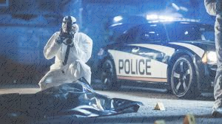
Unidentified Bodies
Agencies are required to enter all information about unidentified bodies found in their jurisdiction into National Crime Information Center (NCIC) system and the Missing Persons Information Clearinghouse (MPCH)
Include all available identifying features and a description of clothing found, jewelry, etc. found on the human remains.
https://nmonesource.com/nmos/nmsa/en/item/4367/index.do#29-15-7
Notes:
Unidentified Bodies
Agencies are required to enter all information about unidentified bodies found in their jurisdiction into National Crime Information Center system and the Missing Persons Information Clearinghouse
Include all available identifying features and a description of clothing found, jewelry, etc. found on the human remains.

Slide 65
Contacts
NM Missing Person’s Clearinghouse
1-800-457-3463/505-827-9026
Fax: 505-827-3399
Email: DPS.MissingPerson@dps.nm.gov
FBI Duty Agent : 505-889-1300
NM Vital Records/State Registrar
1-866-534-0051/505-827-0121
Fax: 505-827-1751

Slide 66

Contacts New Mexico State Police
Sergeant Ricardo Breceda
nmsp.pio@dps.nm.gov
Northern (NORCOM) 505-425-6771
Lieutenant Philip Vargas
Cell: 505-288-7893
PhilipR.Vargas@dps.nm.gov
Officer Wilson Silver
505-946-8290
Wilson.Silver@dps.nm.gov
Officer Amanda Richards
Cell: 505-331-2182
Ricardo.Breceda@dps.nm.gov
505-490-7034
Amanda.Richards@dps.nm.gov
Southern (SOCOM) 575-382-2500
Central (CENCOM) 505-841-9256

Slide 67
Citations
TN Council on Developmental Disabilities. (2023, July 19). What is developmental disability? YouTube. https://www.youtube.com/watch?v=NqLRV_lXVBQ
‌
Hub, P. (2021). What is IDD? In YouTube. https://www.youtube.com/watch?v=rymHXQmiugI
‌
KOAT. (2025, March 1). Turquoise Alert Bill passes Senate unanimously. YouTube. https://www.youtube.com/watch?v=GwToaB7Kecg
‌Begay, M. (2025, March 25). New Turquoise Alert system awaits governor’s signature. KOB.com. https://www.kob.com/new-mexico/four-corners/new-turquoise-alert-system-awaits-governors-signature/
‌
Missing Persons & Alerts - NM Department of Public Safety. (2022, June 15). NM Department of Public Safety. https://www.dps.nm.gov/law-enforcement-records-bureau/missing-persons-alerts/
‌New Mexico Department of Public Safety. (2016). OPR 43: Missing and Endangered Persons Investigations Alerts and Advisories.
‘What is NCIC?’ Overview video | law enforcement (no date) FBI.gov. Available at: https://le.fbi.gov/video-repository/what-is-ncic-overview-video-110923.mp4/view (Accessed: August 2025).
‌International Association of Chiefs of Police. (2021). Missing persons. www.theICAP.org. https://www.theiacp.org/sites/default/files/2021-12/Missing%20Persons%2012-2021%20to%20publish.pdf
‌
National Institute on Aging. (2022, December 8). What Is Dementia? Symptoms, types, and Diagnosis. National Institute on Aging. https://www.nia.nih.gov/health/alzheimers-and-dementia/what-dementia-symptoms-types-and-diagnosis
‌
National Institute on Aging. (2024, July 9). Coping With Alzheimer’s Behaviors: Wandering and Getting Lost. National Institute on Aging. https://www.nia.nih.gov/health/alzheimers-changes-behavior-and-communication/coping-alzheimers-behaviors-wandering-and
‌
Silver Alert Information - NM Department of Public Safety. (2022, December 23). NM Department of Public Safety. https://www.dps.nm.gov/law-enforcement-records-bureau/missing-persons-alerts/silver-alert-information/
Department of Justice. (2020). Guidelines for Issuing AMBER Alerts | AMBER Alert. AMBER Alert. https://amberalert.ojp.gov/about/guidelines-for-issuing-alerts
About AMBER Alert. (2019, October 20). AMBER Alert. https://amberalert.ojp.gov/about
Keeping Hope Alive: The AMBER Alert Program. (2025, January 13). AMBER Alert. https://amberalert.ojp.gov/media/video/806
Turquoise Alert Final. (2025, July 15). New Mexico State Police. https://youtu.be/SoH0mLRVjKM?si=j9xes0pVULFHLDHL

Slide 68
Citations
New Mexico Statutes Annotated. § 29-15-3. “Definitions.” 2025. https://nmonesource.com/nmos/nmsa/en/item/4367/index.do#29-15-2
New Mexico Statutes Annotated. § 29-15-3. “Missing persons information clearinghouse; function.” 2025. https://nmonesource.com/nmos/nmsa/en/item/4367/index.do#29-15-3
New Mexico Statutes Annotated. § 29-15-3. “Silver alert advisory.” 2025. https://nmonesource.com/nmos/nmsa/en/item/4367/index.do#29-15-3.2
New Mexico Statutes Annotated. § 29-15-3.1. “Endangered person advisory.” 2025. https://nmonesource.com/nmos/nmsa/en/item/4367/index.do#29-15-3.1
New Mexico Statutes Annotated. § 29-15-3.3. “Brittany alert advisory.” 2025. https://nmonesource.com/nmos/nmsa/en/item/4367/index.do#29-15-3.3
New Mexico Statutes Annotated. § 29-15-3.5. “Turquoise alert advisory.” 2025. https://nmonesource.com/nmos/nmsa/en/item/4367/index.do#29-15-3.5
New Mexico Statutes Annotated. § 29-15-7. “Law enforcement requirements; missing person reports; unidentified human remains” 2025. https://nmonesource.com/nmos/nmsa/en/item/4367/index.do#29-15-7
New Mexico Statutes Annotated. § 29-15-7.1. “Missing child reports; law enforcement agencies; duties; registrar.” 2025. https://nmonesource.com/nmos/nmsa/en/item/4367/index.do#29-15-7.1
New Mexico Statutes Annotated. § 29-15A-3. “State police; AMBER alert notification plan; declaration of AMBER alert.” 2025. https://nmonesource.com/nmos/nmsa/en/item/4367/index.do#29-15A-3
New Mexico Statutes Annotated. § 28-16A-6. “Eligibility.” 2025. https://nmonesource.com/nmos/nmsa/en/item/4365/index.do#28-16A-6
‌Vargas, P. (2025, December 8). MP LEA Curriculum [Verbal, Email to Rhonda Pierce].Communication from Lieutenant Phil Vargas PIO and Media Relations, New Mexico State Police to Rhonda Pierce, Training and Development NMLEA
Amber Alert Information - NM Department of Public Safety. (2022, December 23). NM Department of Public Safety. https://www.dps.nm.gov/law-enforcement-records-bureau/missing-persons-alerts/amber-alert-informatio
What Happens When Law Enforcement Issues an AMBER Alert - flowchart | AMBER Alert. (n.d.). Amberalert.ojp.gov. https://amberalert.ojp.gov/about/amber-alert-flowchart
‌Patrol First Responder Checklist - AMBER Advocate. (n.d.). Amberadvocate.org. https://amberadvocate.org/resources/investigative-checklists/patrol-first-responder-checklist/
‌
‌

Slide 69
NM Statutes
The Missing Persons Information and Reporting Act:
https://nmonesource.com/nmos/nmsa/en/item/4367/index.do#a15
https://nmonesource.com/nmos/nmsa/en/item/4367/index.do#29-15-3
https://nmonesource.com/nmos/nmsa/en/item/4367/index.do#29-15-7
https://nmonesource.com/nmos/nmsa/en/item/4367/index.do#29-15-7.1
https://nmonesource.com/nmos/nmsa/en/item/4367/index.do#a15A

Slide 70
Summary
The New Mexico Missing Persons Clearinghouse (MPCH) is the Department of Public Safety's centralize repository of information regarding missing persons for use by all New Mexico Law Enforcement agencies.
New Mexico Law Enforcement should gather information about the missing person and surrounding circumstances when conducting a missing persons investigation. New Mexico Law Enforcement should notify appropriate organizations such as the State Police, other local law enforcement agencies, the Missing Persons Clearinghouse (MPCH) and the National Crime Information Center (NCIC), and if applicable, the FBI.
AMBER Alert, Brittany Alert, Silver Alert, Turquoise Alert, and Endangered Persons Advisory are determined by New Mexico state statutes and guidelines.
New Mexico Law Enforcement should notify State Police for Alerts and Advisory. State Police will determine the validity for an alert or advisory.
New Mexico Law Enforcement will submit the appropriate forms to the New Mexico Missing Persons Clearing House (MPCH) regarding a missing person.
Notes:
The New Mexico Missing Persons Clearinghouse is the Department of Public Safety's centralize repository of information regarding missing persons for use by all New Mexico law enforcement agencies.
New Mexico law enforcement should gather information about the missing person and surrounding circumstances when conducting a missing persons investigation. New Mexico Law Enforcement should notify appropriate organizations such as the State Police, other local law enforcement agencies, the Missing Persons Clearinghouse and the national crime information center, and if applicable, the FBI.
AMBER Alert, Brittany Alert, Silver Alert, Turquoise Alert, and Endangered Persons Advisory are determined by New Mexico state statutes and guidelines.
New Mexico Law Enforcement should notify State Police for Alerts and Advisory. State Police will determine the validity for an alert or advisory.
New Mexico Law Enforcement will submit the appropriate forms to the New Mexico Missing Persons Clearing House regarding a missing person.

