Slide 1

Ensuring Child Safety Upon Parental Arrest
New Mexico Law Enforcement Academy Annual In-Service Training Curriculum 2025
NMLEA Accreditation Number: NM260013

Slide 2
Course Goal
To provide law enforcement personnel with information regarding their responsibilities as they pertain to the identification of dependent children when the parents are arrested
Notes:
SLIDE
Course Goal
To provide law enforcement personnel with information regarding their responsibilities as they pertain to the identification of dependent children when the parents are arrested

Slide 3
Objectives
Identify the elements of 29-7-7.3 NMSA 1978 and 31-1-8 NMSA 1978
Discuss how the arrest and specific actions made by officers can be traumatic to children and how officers can assist in mitigating any long-term effects.
Identify the procedures required to meet statute to include making arrangements for the temporary care of a child
Notes:
SLIDE
Objectives
1
Identify the elements of
a. 29-7-7.3 NMSA 1978
b. 31-1-8 NMSA 1978
2
Discuss how the arrest and specific actions made by officers can be traumatic to children and how officers can assist in mitigating any long-term effects.
3
Identify the procedures required to meet statute to include making arrangements for the temporary care of a child

Slide 4

New Mexico Statute 29-7-7.3. Ensuring child safety upon arrest; training.
Training for ensuring child safety upon the arrest of a parent or guardian shall be included in the curriculum of each basic law enforcement training class and as a component of in-service training each year for certified police officers.
Notes:
SLIDE
New Mexico Statute 29-7-7.3. Ensuring child safety upon arrest; training.
Training for ensuring child safety upon the arrest of a parent or guardian shall be included in the curriculum of each basic law enforcement training class and as a component of in-service training each year for certified police officers.

Slide 5
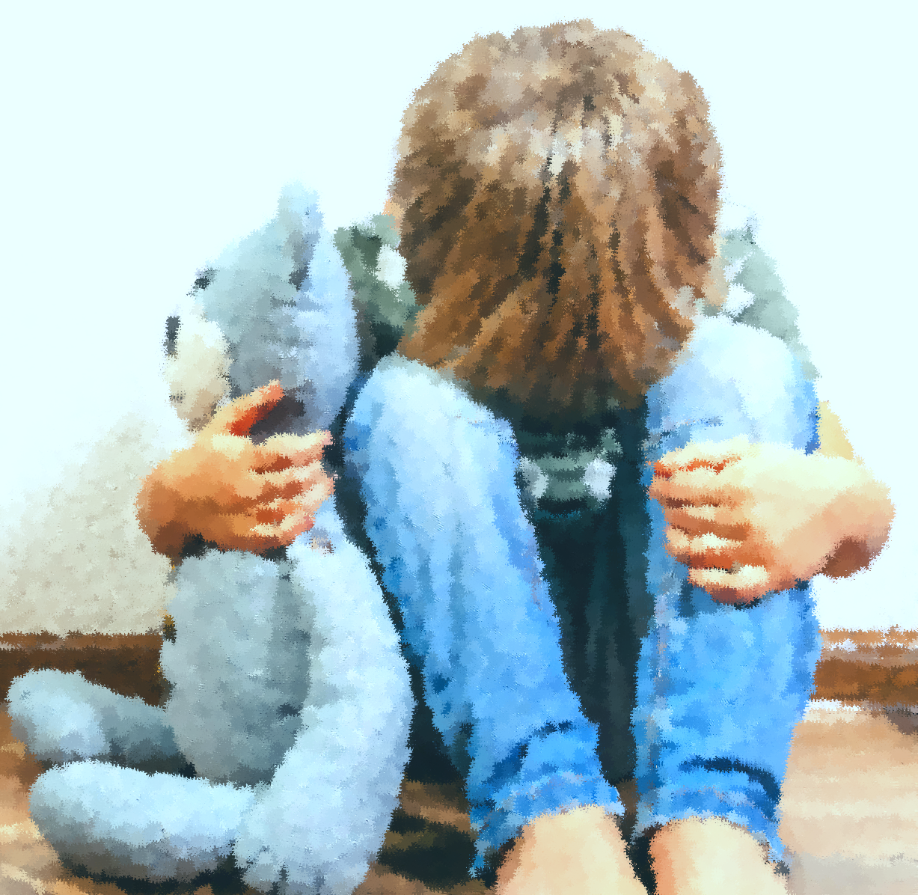
Childhood Trauma
Notes:
SLIDE
Childhood Trauma
INSTRUCTOR
In this section, we will be discussing trauma, the effect of trauma on children, and the long-term effects of childhood trauma on adults.

Slide 6
What is Trauma?
Trauma is an experience(s) that causes intense physical or emotional stress.
It can have lasting negative effects on a person’s well- being.
Notes:
SLIDE
What is trauma?
Trauma is an experience(s) that causes intense physical or emotional stress.
It can have lasting negative effects on a person’s well-being.
Instructor Note:
It is important to know that individuals can heal and recover from psychological trauma.
Trauma results when an individual is exposed to an event that overwhelms their ability to cope. Whether an individual experiences trauma reactions depends on both characteristics of the event and characteristics of the individual. There are risk factors that contribute to whether or not a child develops trauma, such as preexisting mental health conditions, the physical or emotional proximity to the event, and the resources the child has around them to help them cope with and process difficult events.

Slide 7
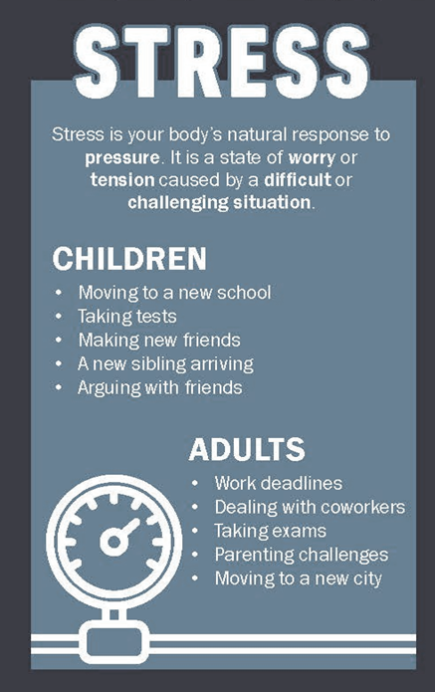
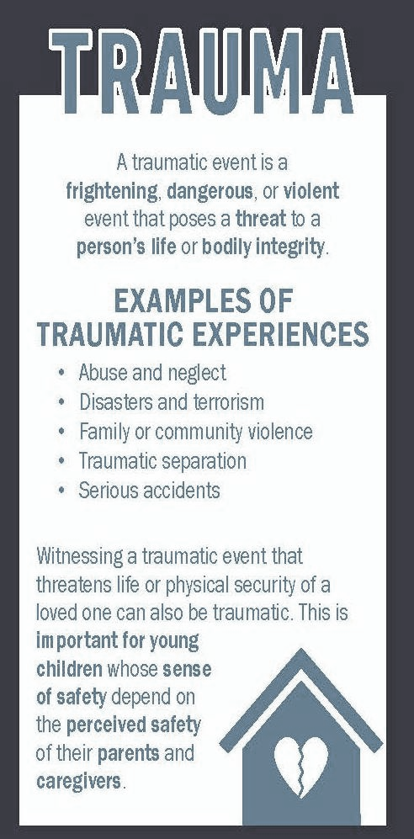
What is the difference between stress and trauma?
Stress is your body’s natural response to pressure. It is a state of worry or tension caused by a difficult or challenging situation.
A traumatic event is a frightening, dangerous, or violent event that poses a threat to a person’s life or bodily integrity.
Notes:
SLIDE
What is the difference between stress and trauma?
Stress
Stress is your body’s natural response to pressure. It is a state of worry or tension caused by a difficult or challenging situation.
INSTRUCTOR NOTES
What are some examples of childhood stress?
Child Examples of Stress
Moving to a new school
• Taking tests
• Making new friends
• A new sibling arriving
• Arguing with friends
What are some examples of adult stress?
Adult Examples of Stress
• Work deadlines
• Dealing with coworkers
• Taking exams
• Parenting challenges
• Moving to a new city
SLIDE
A traumatic event is a frightening, dangerous, or violent event that poses a threat to a person’s life or bodily integrity.
INSTRUCTOR NOTE
Trauma is an experience or experiences that cause intense physical and/or emotional stress.
What are some examples of traumatic experiences?
EXAMPLES OF TRAUMATIC EXPERIENCES
• Abuse and neglect
• Disasters and terrorism
• Family or community violence
• Traumatic separation
• Serious accidents
Witnessing a traumatic event that threatens life or physical security of a loved one can also be traumatic. This is important for young children whose sense of safety depend on the perceived safety of their parents and caregivers.
https://www.nctsn.org/resources/understanding-stress-vs-trauma

Slide 8
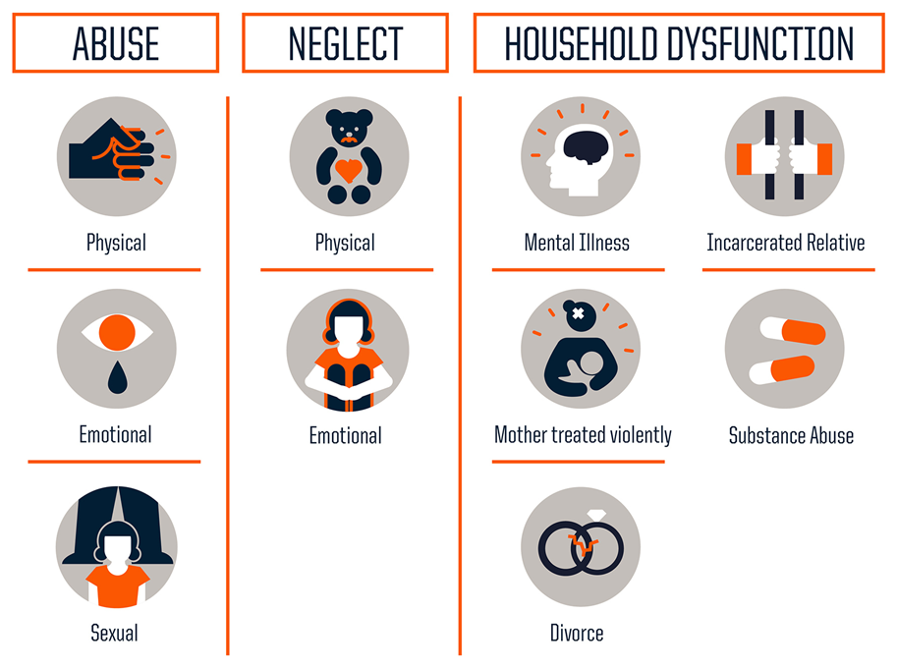
What are Adverse Childhood Experiences?
Adverse Childhood Experiences, or ACEs, are potentially traumatic events that occur in childhood (0-18 years).
Notes:
SLIDE
What are adverse childhood experiences?
Adverse childhood experiences, or ACEs, are potentially traumatic events that occur in childhood (0-18 years).
INSTRUCTOR NOTES:
Examples include:
• Experiencing violence, child abuse, child sexual abuse, or neglect.
• Witnessing violence in the home or community.
• Having a family member attempt or die by suicide.
Also included are aspects of the child’s environment that can undermine their sense of safety, stability, and bonding. Examples can include growing up in a household with:
• Substance use problems such as a drug addicted parent or alcoholic family member.
• Mental health problems.
• Instability due to parental separation.
• Instability due to household members being in jail or prison
https://www.cdc.gov/aces/about/index.html

Slide 9



Negative Impacts of Adverse Childhood Experiences on Adults
Physical Health Issues
Possible Risk Outcomes:
Behavioral Health Issues
Possible Risk Outcomes:
Possible Risk Outcomes:
Cardiovascular Disease
Cancer
Diabetes
Stroke
Autoimmune Disorders
Obesity
Mental Health Issues
Post-Traumatic Stress Disorder (PTSD)
Anxiety Disorders
Mood Disorders
Depression Disorders
Substance Use Disorder
Domestic Violence:
(Victimization & Perpetration)
Eating Disorders
Criminal Behavior
Self-harm
Suicide
Notes:
SLIDE
Negative Impacts of Adverse Childhood Experiences on Adults
Physical Health Issues
Possible Risk Outcomes:
Cardiovascular Disease
Cancer
Diabetes
Stroke
Autoimmune Disorders
Obesity
Mental Health Issues
Possible Risk Outcomes:
Post-Traumatic Stress Disorder (PTSD)
Anxiety Disorders
Mood Disorders
Depression Disorders
Behavioral Health Issues
Possible Risk Outcomes:
Substance Use Disorder
Domestic Violence:
(Victimization & Perpetration)
Eating Disorders
Criminal Behavior
Self-harm
Suicide

Slide 10
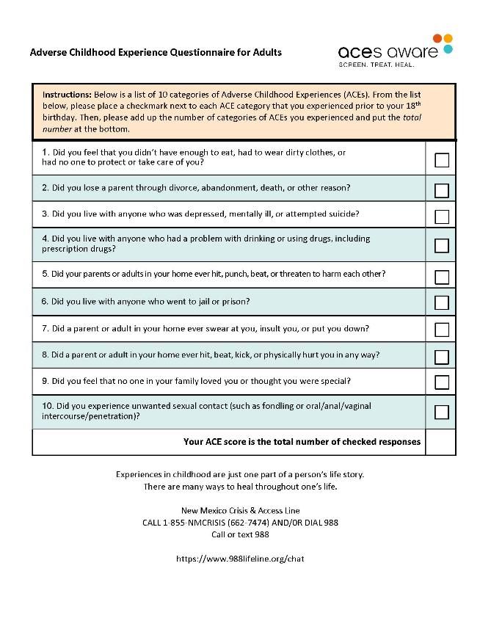
Take the ACE Self-Survey
This is a self-survey for adults and will not be shared out to the instructor or audience.
This survey is help you understand Adverse Childhood Experiences in your own life and in the lives of the children in the community you serve.
Notes:
SLIDE
Take the ACE Self-Survey
This is a self-survey for adults and will not be shared out to the instructor or audience.
This survey is help you understand Adverse Childhood Experiences in your own life and in the lives of the children in the community you serve.
INSTRUCTOR NOTE:
Emphasize this is a private survey and is not to be shared out.
Pass out copies of the ACEs self survey, which individuals can read through and make a mental tally of their own score
Instructions:
The following is a self-survey questionnaire for Adults about Adverse Childhood Experiences during their childhoods.
For each Yes or No answer of the 10 questions, each "Yes" answer will be given one (1) point.
The total points determine an adult's ACE Score (0 to 10).
This is a self-assessment and no data is collected.

Slide 11
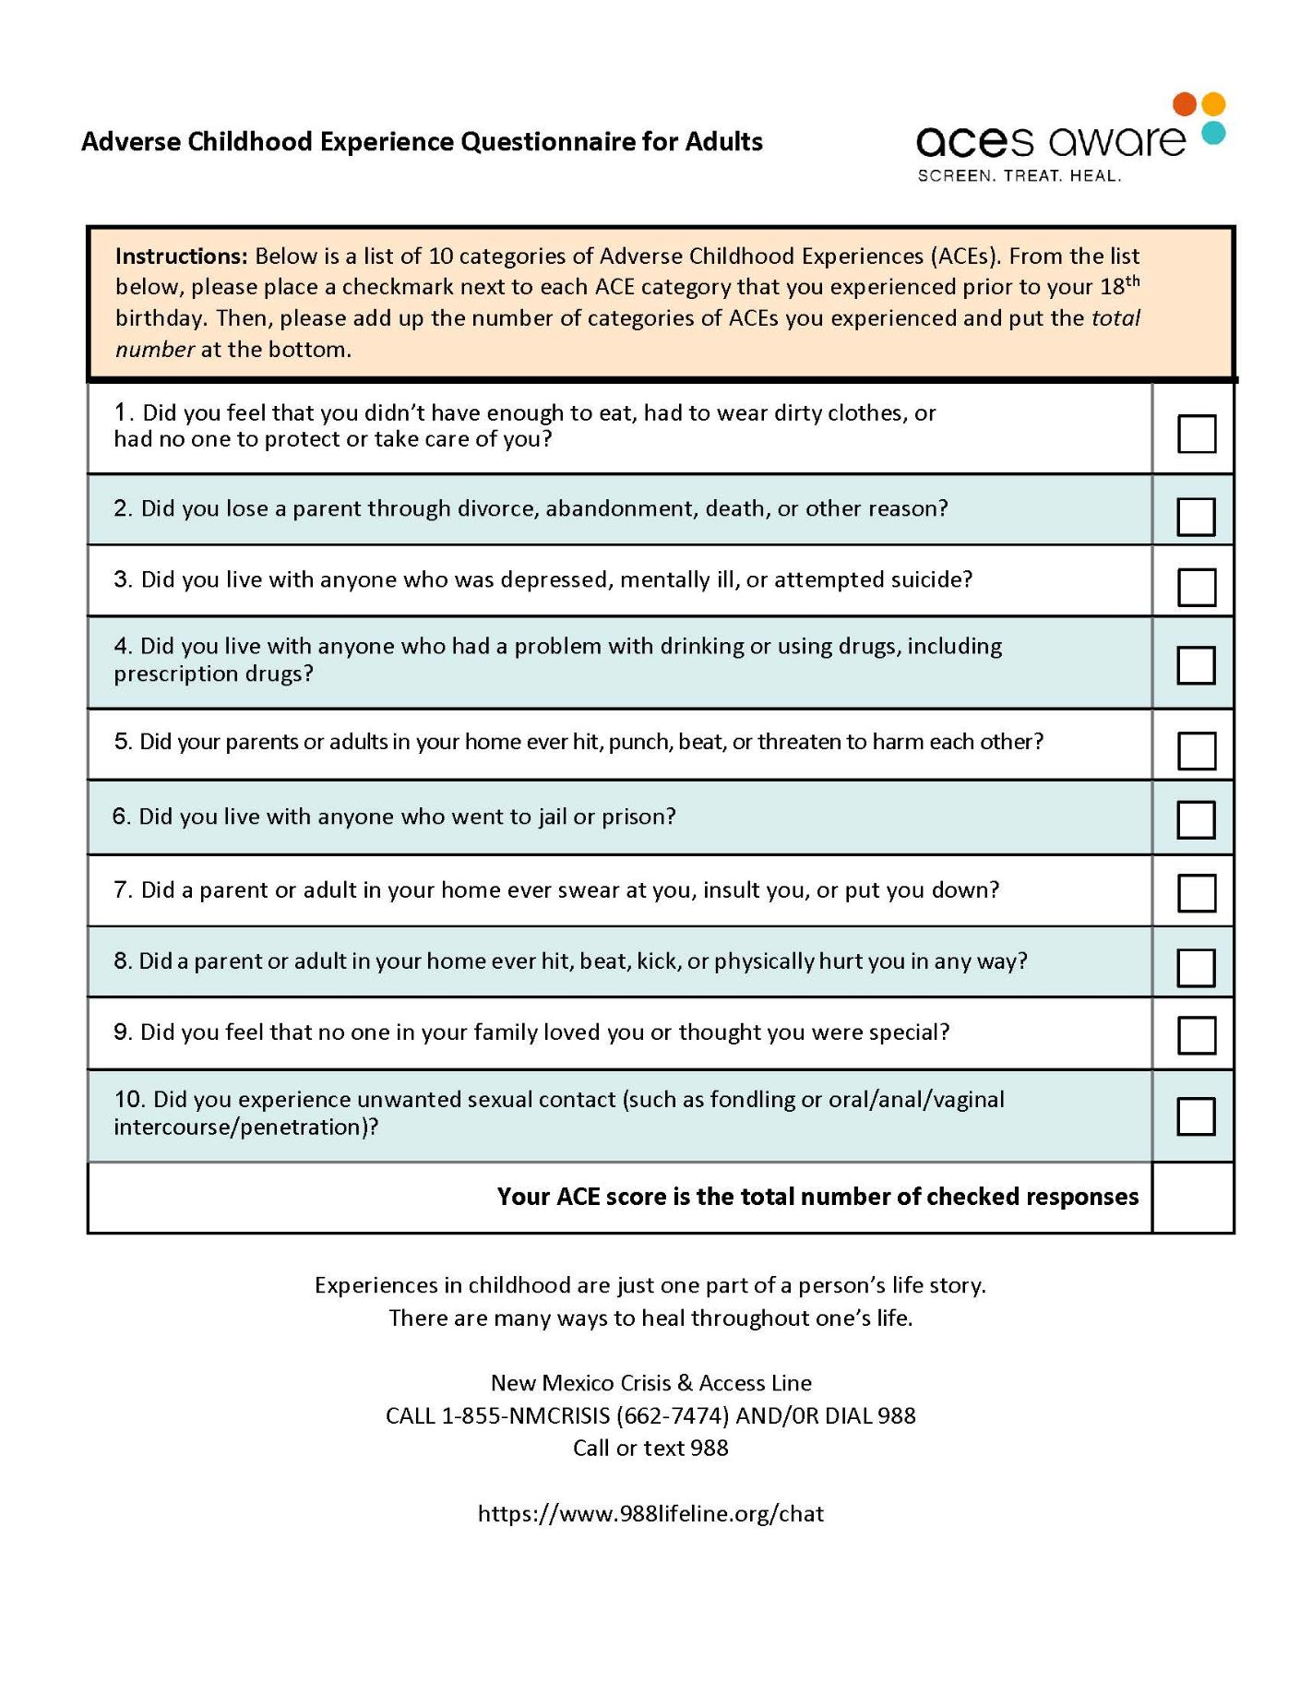


Notes:
SLIDE
ACE questions
1. Did you feel that you didn’t have enough to eat, had to wear dirty clothes, or had no one to protect or take care of you?
2. Did you lose a parent through divorce, abandonment, death, or other reason?
3. Did you live with anyone who was depressed, mentally ill, or attempted suicide?
4. Did you live with anyone who had a problem with drinking or using drugs, including prescription drugs?
5. Did your parents or adults in your home ever hit, punch, beat, or threaten to harm each other?
6. Did you live with anyone who went to jail or prison?
7. Did a parent or adult in your home ever swear at you, insult you, or put you down?
8. Did a parent or adult in your home ever hit, beat, kick, or physically hurt you in any way?
9. Did you feel that no one in your family loved you or thought you were special?
10. Did you experience unwanted sexual contact (such as fondling or oral/anal/vaginal intercourse/penetration)?

Slide 12
ACE Self-Survey
What does the score mean?
According to studies, Adults with ACEs scores of 4 or more have an increased risk of negative adult health outcomes, including physical health issues, alcoholism, drug abuse, and depression.
Notes:
SLIDE
What does the score mean?
According to studies, Adults with ACEs scores of 4 or more have an increased risk of negative adult health outcomes, including physical health issues, alcoholism, drug abuse, and depression.
INSTRUCTOR NOTES
There are ways to counter the impact of ACEs – (see next slide)
For more about ACEs and other resources see the links below.
More About ACEs and Other Resources
https://www.cdc.gov/aces/about/index.html
https://988nm.org/
https://www.cdc.gov/vitalsigns/aces/index.html
https://www.sciencedirect.com/science/article/abs/pii/S0145213419302662
https://developingchild.harvard.edu/resources/handouts-tools/take-the-aces-quiz/

Slide 13



Positive Childhood Experiences
Can help to mitigate the outcomes of ACEs
Feeling safe and protected by an adult in the home
Feeling supported by friends and family
Having non-parent adults take a genuine interest in your well being as a child
Feeling a sense of belonging and community
Notes:
INSTRUCTOR
Studies have also shown that Positive Childhood Experiences, such as feeling safe and protected by an adult in the home, feeling supported by friends and family, and having non-parent adults take a genuine interest in your well being as a child, and feeling a sense of belonging and community can help counter such outcomes of ACEs.
SLIDE
Positive Childhood Experiences
Can help to mitigate the outcomes of ACEs
Feeling safe and protected by an adult in the home
Feeling supported by friends and family
Having non-parent adults take a genuine interest in your well being as a child
Feeling a sense of belonging and community
INSTRUCTOR
Examples of:
Positive Childhood Experiences
Felt able to talk to their family about feelings
Felt their family stood by them during difficult times
Enjoyed participating in community traditions
Felt a sense of belonging in high school
Felt supported by friends
Had at least two non-parent adults who took genuine interest in them
Felt safe and protected by an adult in their home
Tree analogy video
https://www.youtube.com/watch?v=AfX0wBWpfLU&t=39s
https://childwellbeingandtrauma.org/healing-and-prevention/positive-childhood-experiences/

Slide 14

Building Resilience
Resilience is the ability to recover from life’s difficulties.
Protective factors can help children build resilience and cope with the negative effects of
Adverse Childhood Experiences (ACEs).
Notes:
SLIDE
Building Resilience
Resilience is the ability to recover from life’s difficulties.
Protective factors can help children build resilience and cope with the negative effects of
Adverse Childhood Experiences (ACEs).
INSTRUCTOR
Not every child who experiences one or more ACEs, however, has poor long-term health outcomes. Children may cope successfully with these traumatic experiences. This process of overcoming adversity is called resilience.
Resilience is the ability to recover from life’s difficulties. Resilience is created by positive childhood experiences which include external protective factors, and also internal factors, like the individual’s personality, temperament, and character
Protective factors can help children build resilience and cope with the negative effects of adverse childhood experiences (ACEs). (Protective Factors are the bricks that create positive childhood experiences)
Protective factors, such as the present of an adult who makes a child feel safe, can build resilience.
https://pmc.ncbi.nlm.nih.gov/articles/PMC7163854/#CR53

Slide 15
Questions
What is the difference between stress and trauma?
What are ACEs? Why are they relevant?
What is resilience?
What are protective factors? Examples?
Notes:
SLIDE
Questions
What is the difference between stress and trauma?
What are ACEs? Why are they relevant?
What is resilience?
What are protective factors? Examples?
INSTRUCTOR NOTES
Answer is small groups or as a class discussion.

Slide 16
Trauma Associated with Arrest of a Parent
Notes:
SLIDE
Trauma Associated with arrest of a parent
INSTRUCTOR
In this section, we will be discussing how parental arrest is traumatic for children, and how law enforcement, by following state statutes and best practices, can be a protective factor for children during this stressful situation.

Slide 17
When a child is experiencing the arrest of a parent, what can be traumatic for a child?
Discussion Question
Notes:
SLIDE
Discussion question
When a child is experiencing the arrest of their parents, what can be traumatic for a child?
INSTRUCTOR
Facilitate discussion about what can be traumatic for a child during a parent's arrest
Examples
Seeing a parent arrested by police
Seeing a parent upset or hurt
Being separated from a parent
Scary chaotic situation
Fear
Feelings of helplessness
Not knowing what will happen next

Slide 18
Witnessing a violent crime or other event, such as the arrest of a parent, can cause emotional harm to children.
Law Enforcement Officers can assist in reducing the long-term effects of the trauma for children.
Notes:
SLIDE
Witnessing a violent crime or other event, such as the arrest of a parent, are causes of emotional harm to children.
Law enforcement can assist in reducing the long-term effects of the trauma for children.

Slide 19
The law enforcement officer is one of the protective factors that children have in decreasing a potential harmful event.
Notes:
SLIDE
The law enforcement officer is one of the protective factors that children have in decreasing the harm of a traumatic event.

Slide 20
What does “mitigating a child’s trauma” mean?
What steps can a law enforcement officer take to mitigate a child’s trauma during the arrest of a parent?
Notes:
SLIDE
What does “mitigating a child’s trauma” mean?
What steps can a law enforcement officer take to mitigate a child’s trauma during the arrest of a parent?
INSTRUCTOR
Mitigating a child’s trauma means making the traumatic event less harmful or less painful for children
Discussion as a class or in small groups
Some examples on the following slide

Slide 21
The Role of Law Enforcement is Mitigating the Trauma for Children
When planning arrest/search warrant, consider age and location of children.
Do not to arrest parents in front of children, if possible.
Avoid sirens and lights in a non-emergency situation and where the use is discretionary.
Notes:
SLIDE
The Role of Law Enforcement is Mitigating the Trauma for Children
When planning arrest/search warrant, consider age and location of children.
Do not arrest parents in front of their children if it is at all possible.
Avoid sirens and lights in a non-emergency situation and where the use is discretionary.

Slide 22
Procedures Regarding Children of Arrested Parents
Notes:
SLIDE
Procedures Regarding Children of Arrested Parents
INSTRUCTOR
In this section we will be discussing some procedures regarding the children of arrested parents. The goal of the responding officer is to minimize the trauma of the actual arrest for the children and the disruption it causes to their lives. Officers must provide the most supportive environment possible for the children and determine what the best alternative care is.

Slide 23
Section 31-1-8 NMSA
A state or local law enforcement officer who arrests a person shall, at the time of the arrest, inquire whether the person is a parent or guardian of minor or dependent children who may be at risk as a result of the arrest.
Notes:
SLIDE
Section 31-1-8 NMSA
A state or local law enforcement officer who arrests a person shall, at the time of the arrest, inquire whether the person is a parent or guardian of minor or dependent children who may be at risk as a result of the arrest.
INSTRUCTOR NOTE
The officer should document they asked and document the response.

Slide 24
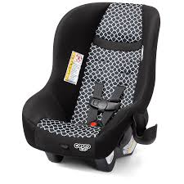



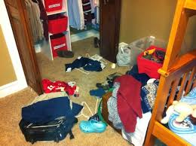
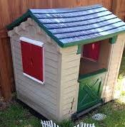
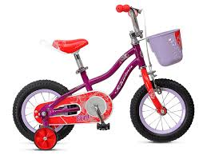
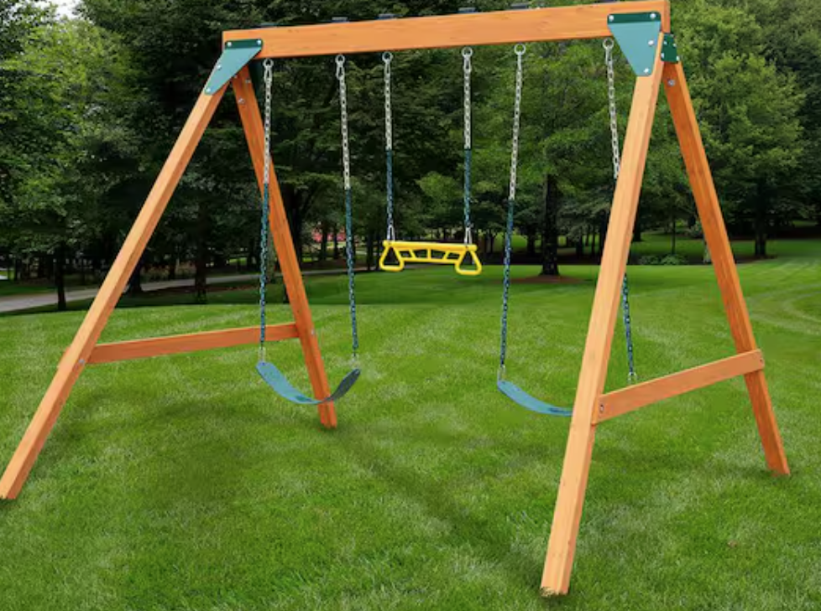
Things to Look For:
Bottles
Indoor Swings/Chairs
Outdoor Children’s Items
Cars Seats
Toys
Clothing
Notes:
SLIDE
Things to Look For
Car Seats
Toys
Clothes
Bottles
Indoor Swings/Chairs
Outdoor Children’s Items
INSTRUCTOR
Awareness of children's items on the scene, before or at the time of arrest, may indicate a child is or is likely to be present

Slide 25
Things to Ask Arrestee:
“Do you have any children that depend on you to take care of them?”
“Are there any children in the house?”
“Where are they?”
The inquiry should include any child who may not be present at the time of parental arrest.
Notes:
SLIDE
Things to Ask Arrestee:
“Do you have any children that depend on you to take care of them?”
“Are there any children in the house?”
“Where are they?”
The inquiry should include any child who may not be present at the time of parental arrest.
INSTRUCTOR
There are questions officers should ask the arrestee at every arrest: such as
Do you have children that depend on you to take care of them?
Note that parents will not always tell you whether they have children who live with them. Some parents may fear the child will be taken away by Child Protective Services, or that the arrest may result in a loss of custody.
Officer should also ask:
Where are the children?
Who can take care of them?
The inquiry includes any child who may not be present at the time of arrest, but is expected to be picked up from or is returning
home from school, a babysitter, a friend’s house, or any other location or activity.
This New Mexico statute requirement of asking the parent at the time of arrest is to ensure no child is at home alone without appropriate supervision or care.

Slide 26
Section 31-1-8 NMSA
Identification of minor or dependent children at the time of parental arrest
The officer shall make reasonable efforts to ensure the safety of minor or dependent children at risk as a result of an arrest
Notes:
SLIDE
Section 31-1-8 NMSA
Identification of minor or dependent children at the time of parental arrest
The officer shall make reasonable efforts to ensure the safety of minor or dependent children at risk as a result of an arrest

Slide 27
Section 31-1-8 NMSA
The officer shall make reasonable efforts to ensure the safety of minor or dependent children at risk as a result of an arrest
reasonable efforts
Notes:
SLIDE
Section 31-1-8 NMSA
The officer shall make reasonable efforts to ensure the safety of minor or dependent children at risk as a result of an arrest
INSTRUCTOR
What are reasonable efforts?
Reasonable is defined as:
Just, proper, fit and appropriate to the end
or
appropriate in the circumstances, moderate, fair, equitable.
The officer establishes this “reasonable effort” by such actions as:
First asking the arrestee if there are any minor or dependent children at risk because of the arrest,
and,
If an alternative care giver is located, ensuring a “background check” through Children Youth and Families Department Statewide Central Intake, Sky, is completed and at a minimum a local arrest history check is made

Slide 28
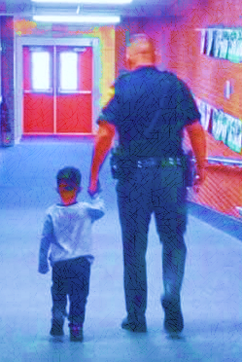
Mitigating Trauma for Children at the Time of Parental Arrest
If it is safe, the parent should be allowed to explain to the child what is happening.
If it’s not safe, the officer will explain to the child.
Use age-appropriate language
Reassure the child that parent and child will be taken care of
Notes:
SLIDE
Mitigating Trauma for Children at the time of parental arrest:
If it is safe, the parent should be allowed to explain to the child what is happening.
If it’s not safe, the officer will explain to the child.
Use Age-appropriate language
Reassure the child that parent and child will be taken care of.

Slide 29

Talking to Children
Introductions
Introduce yourself:
Hi, I am Officer ___________
Use the child’s name.
Use simple, age-appropriate language.
Sit at the child’s physical eye level.
Notes:
SLIDE
Talking to Children:
Introductions.
Introduce yourself:
Hi, I am Officer ___________
Use the child’s name.
Use simple, age-appropriate language.
Sit at the child’s physical eye level
INSTRUCTOR NOTES
Sitting at the child’s physical eye level helps to create a more positive interaction.

Slide 30
Talking to Children
The Role of a Police Officer
Explain that your role as a police officer is to keep the child safe.
Acknowledge the child’s right to remain silent.
"It's alright if you don't want to talk..."
Recognize the child’s loyalty to the parent.
Don’t criticize the parent(s).
Notes:
SLIDE
Talking to Children: The Role of a Police Officer.
Explain that your role as a police officer is to keep the child safe.
Acknowledge the child’s right to remain silent with child friendly statements like
"It's alright if you don't want to talk..."
Recognize the child’s loyalty to the parent.
Don’t criticize the parent(s) in front of the child.

Slide 31
Talking to Children
Asking & Answering Questions
Limit the use of questions that require a yes/no answer.
Ask open-ended questions:
“ Tell me about______.”
“What happened when______?”
Use simple reflection, by repeating or restating what the child said in your own words, to make sure there is clarity.
"So you said <this happened> then <this happened>... did I get that right?"
Notes:
SLIDE
Talking to Children: Asking and Answering Questions;
Limit the use of questions that require just a yes/no answer;
Ask open-ended questions:
“ Tell me about______.”
“What happened when______?”
Use simple reflection, by repeating or restating what the child said in your own words, to make sure there is clarity.
"So you said <this happened> then <this happened>... did I get that right?"
INSTRUCTOR NOTES
Ask open-ended questions, that give the child more space for a thoughtful response:
Prompts like “ Tell me about....”;
Or “What happened when....”; are examples of opened-ended questions.
Use simple reflection, by repeating or restating what the child said to you, in your own words; This makes sure there is clarity and let's the child know you have been listening to them;
"So you said ...then repeat or rephrase what the child said,... did I get that right;" is an example of a simple reflective statement.

Slide 32
Talking to Children
Asking & Answering Questions
Answer any questions that the child may have.
Ask one question at a time.
Check that the child understands your question.
Give the child permission to tell you when the child doesn't know the answer or does not understand a word or a question.
Avoid “why” questions.
Wait for the child to listen to your question, to think about it, and then to respond to it.
Notes:
SLIDE
Talking to Children: Asking and Answering Questions;
Answer any questions that the child may have.
Ask one question at a time.
Check that the child understands your question.
Give the child permission to tell you when the child doesn't know the answer or does not understand a word or a question.
Avoid “why” questions.
Wait for the child to listen to your question, to think about it, and then to respond to it.
INSTRUCTOR NOTE
Why should you avoid WHY questions with Children?
Avoid “why” questions,
1. They are difficult for young children to understand and answer, depending on the child’s age and their cognitive development
“What” and “Where” questions – 2 to 3 years old
“Who” questions – 3 to 4 years old
“Why” and “How” questions – 4 to 5 years old
2. They make older children feel judged, defensive, and/or guilty, for themselves or their parents, and shuts down communication

Slide 33
Talking to Children
Listening
Avoid rushing the child; let them have time to process thoughts and feelings.
Observe non-verbal communication.
REMEMBER:
The child’s body is responding to the stressful situation, and this may affect his or her ability to listen, reason, and retain information.
This may also affect the child’s emotional and physical responses to what is happening.
Notes:
SLIDE
Talking to Children: Listening.
Avoid rushing the child; let them have time to process thoughts and feelings;
Observe non-verbal communication;
REMEMBER:
The child’s body is responding to the stressful situation, and this may affect his or her ability to listen, reason and retain information.
This may also affect the child’s emotional and physical responses to what is happening.

Slide 34

Talking to Children
Other Tips
Make no assumptions about the child’s abilities based on age.
Allow the child to hold onto a stuffed animal or other object for comfort.
Do not make promises that you will not be able to fulfill.
Notes:
SLIDE
Talking to Children: Other Tips.
Make no assumptions about the child’s abilities based on age.
Allow the child to hold onto a stuffed animal or other object for comfort.
Do not make promises that you will not be able to fulfill.

Slide 35
Finding a Caregiver for the Child
Parent’s Wishes
Barring drug use, weapons or criminal behavior, a parent’s wishes shall be respected in regard to their children’s care.
Determining if a Co-Parent is Available
The officer shall determine if co-parent or legal guardian is available.
The arrested parent may risk being charged with abuse and neglect, if information is withheld regarding their children.
Notes:
SLIDE
Finding a Caregiver for the Child
Parent's Wishes
Barring drug use, weapons or criminal behavior, a parent’s wishes shall be respected in regard to their children’s care.
The arrested parent may risk being charged with abuse and neglect, if information is withheld regarding their children.
Determining if a Co-Parent is Available
The officer shall determine if co-parent or legal guardian is available.
INSTRUCTOR
The individual being arrested should be asked if there is a co-parent or legal guardian who can be contacted to care for the child. If a co-parent or legal guardian is not available, the officer should determine whether or not there is a relative who could be contacted

Slide 36
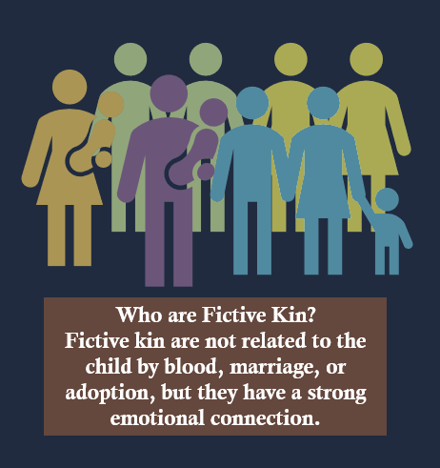
Finding a Caregiver for the Child
Finding Relatives or Fictive Kin
Find other adult relatives or fictive kin willing to take the child.
Notes:
SLIDE
Finding a Caregiver for the Child
Finding Relatives or Fictive Kin
Find other adult relatives or fictive kin willing to take the child.
INSTRUCTOR
If a co-parent is not available, an officer can identify a relative to care for the child.
if neither co-parent nor a relative can be identified, then an officer should attempt to identify a “fictive kin” who could be contacted to care for the child.
What does Fictive kin mean?
Who are “Fictive KIN”?
SLIDE
Who are Fictive Kin?
Fictive Kin are not related to the child by blood, marriage, or adoption, but they have a strong emotional connection.
INSTRUCTOR
Fictive kin
is anyone who is known to and in a trusted relationship with the child but is not a blood relative.
Some examples of fictive kinship are godparents, close family friends, long-time neighbors, or mentors.

Slide 37

Finding a Caregiver for the Child
Check Criminal History
Adults with criminal history of sexual crimes or crimes against children are ineligible as child placements.
Notes:
SLIDE
Finding a Caregiver for the Child
Check Criminal History
Adults with criminal histories of sexual crimes or crimes against children are ineligible as child placements.
INSTRUCTOR
Prior to placing a child with an alternative caregiver, law enforcement must contact CYFD Statewide Central Intake (SCI) (SkY) for an abuse/neglect background check and conduct a local check

Slide 38
When an Alternative Caregiver is Located
Provide the alternative caregiver with as much information as possible regarding:
The arrest of the parent/guardian of the child
Location of the jail
Charges
Estimated amount of time the parent/guardian could be in jail
Notes:
SLIDE
When an Alternative Caregiver is Located
Provide the alternative caregiver with as much information as possible regarding:
The arrest of the parent/guardian of the child
Location of the jail
Charges
Estimated amount of time the parent/guardian could be in jail
INSTRUCTOR
Once the officer feels the alternative caregiver can provide a safe environment for the child, the officer must provide the caregiver with as much information as possible regarding the arrest of the parent or guardian. This information should include but is not limited to:
The Location of the jail
and Charges
The alternative care giver should also be advised about the amount of time the parent or guardian could possibly spend in jail, which is dependent upon the charges and whether the parent can make bond

Slide 39
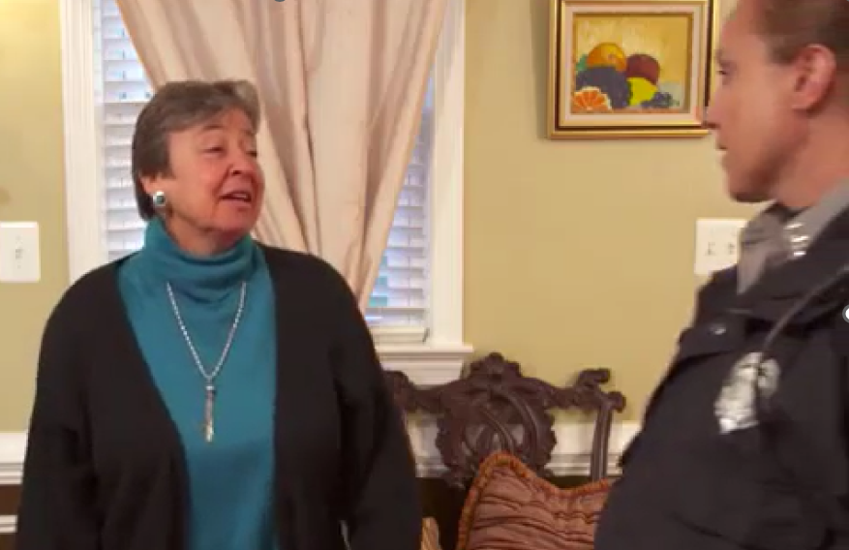
The Alternative Caregiver Should Be Advised
The alternative caregiver is accepting responsibility for the child while the parent/guardian is in jail
About any information pertaining to the child’s physical health, medications, etc.
Notes:
SLIDE
The Alternative Caregiver Should Be Advised
The alternative caregiver is accepting responsibility for the child while the parent/guardian is in jail
About any information pertaining to the child’s physical health, medications, etc.

Slide 40
Children, Youth & Families Department should be called if an alternative caregiver cannot be located. However, CYFD is a last resort.
Notes:
SLIDE
Children Youth and Families Department should be called if an alternative care giver cannot be located; however, CYFD is a last resort.

Slide 41

Procedures
If a child is placed with an adult other than the non-arrested parent, officers shall check with CYFD’s State Centralized Intake (SCI) regarding history of child abuse or neglect.
1-855-333-7233 (Statewide)
505-841-6100 (Albuquerque)
https://www.cyfd.nm.gov/
Notes:
SLIDE
Procedures
If a child is placed with an adult other than the non-arrested parent, officers must check with New Mexico's Children, Youth, and Families, Department, State Centralized Intake (SCI sky) regarding that adult's possible history of child abuse or neglect.
1-855-333-7233 (Statewide)
505-841-6100 (Albuquerque)

Slide 42

Procedures
Procedures
CYFD’s State Centralized Intake (SCI) will ask to verify your identity
If no one is available, SCI will provide numbers to local shelters
Notes:
SLIDE
Procedures
CYFD’s State Centralized Intake (SCI) will ask to verify your identity
If no one is available, SCI will provide numbers to local shelters
INSTRUCTOR
When calling Statewide Central Intake (SCI Sky), the officer should select the Law Enforcement option.
During the intake:
the Intake Worker will ask for the officer's badge number and phone number; and may ask for the officer's supervisor's name and phone number.
The officer should provide as much information about the alternative caregiver as possible, including name, date of birth, and address.
The intake worker should be told what type of information is being sought about the individual in question (outstanding referrals, substantiated cases, etc.) Sky can also provide a list of shelters, if applicable to the situation, for older children.

Slide 43
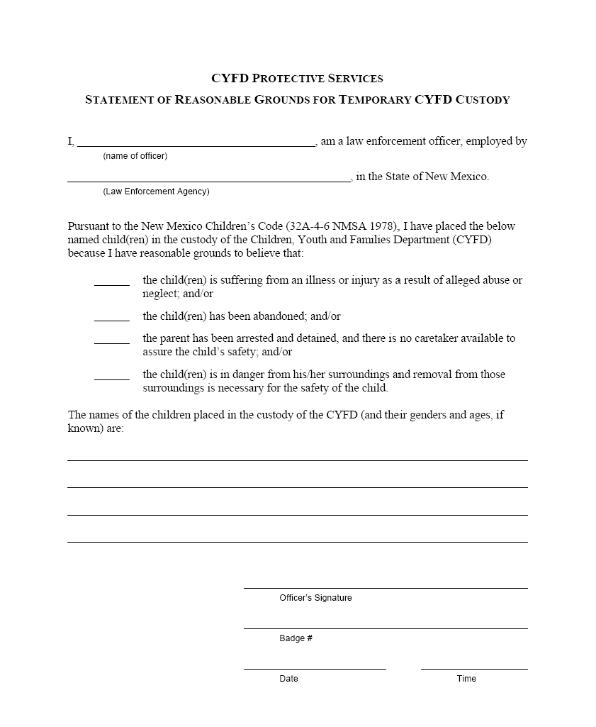
Procedures
If an officer believes protective custody is necessary:
SCI will notify the Protective Services Division of CYFD
Officer will be asked for “Statement of Reasonable Grounds for Emergency Custody”
Notes:
SLIDE
Procedures
If an officer believes protective custody is necessary:
SCI, will notify the Protective Services Division of the Children Youth and Families Department.
The Officer will be asked for a “Statement of Reasonable Grounds for Emergency Custody”:
INSTRUCTOR NOTE
Student materials have a copy of the Statement of Reasonable Grounds form

Slide 44
Procedures
Procedures
If children are in school, the officer shall contact the school
Notify principal, school resource officer and parent’s preference for placement
Notes:
SLIDE
Procedures
If children are in school, the officer shall contact the school
Notify principal, school resource officer and parent’s preference for placement

Slide 45

Procedures
Officer’s report should include:
Names and contact info where
child is placed
Names of CYFD and school
workers contacted
Names of family members mentioned regardless if children are placed with them or not.
(Important for possible future placement)
Notes:
SLIDE
Procedures
Officer’s report should include:
Names and contact info where
child is placed
Names of CYFD and school
workers contacted
Names of family members mentioned regardless if children are placed with them or not.
(Important for possible future placement)

Slide 46
A
Child
Always ask if the arrestee is the parent or guardian of minor or dependent children.
Responsible Adult
Identify an alternate caregiver.
Ensure Child Safety
If no alternate caregiver can be located, contact CYFD.
Assess Arrest Conditions
If it is safe to do so, make the arrest away from the child.
If it is safe to do so, allow the arrestee to explain to his or her child that they will be cared for.
Confirm that adult is appropriate.
The officer is responsible for the well-being of the child until transfer of custody.
C
E
R
Notes:
SLIDE
CARE
C - Child
Always ask if the arrestee is the parent or guardian of minor or dependent children.
INSTRUCTOR NOTE
If the officer observes car seats, children’s toys, etc., in the vehicle or immediate area of the arrest, the officer may ask where the children are and who is taking care of them.
SLIDE
A - Assess Arrest Conditions
If it is safe to do so, make the arrest away from the child.
If it is safe to do so, allow the arrestee to explain to his or her child that they will be cared for.
INSTRUCTOR NOTE
When possible, consider the ages and location of children when deciding when and where to make the arrest.
SLIDE
R - Responsible Adult
Identify an alternate caregiver.
Confirm that adult is appropriate.
INSTRUCTOR NOTE
If children are present at the time of arrest, or if the arrestee indicates that there are children who will be left unattended, identify an alternate caregiver.
Confirm that adult is appropriate.
When placing a child with someone other than a parent or guardian, confirm that the adult is appropriate (any history of sexual crimes or violence against children will make the adult ineligible to assume custodial care):
1. Contact SCI for an abuse/neglect background check.
#SAFE (#7233) from a mobile phone
or 1-855-333-SAFE (7233)
2. Complete a preliminary criminal background check.
SLIDE
E - Ensure Child Safety
If no alternate caregiver can be located, contact CYFD.
The officer is responsible for the well-being of the child until transfer of custody.
INSTRUCTOR NOTE
The officer is responsible for identifying an alternate caregiver. If an alternate caregiver cannot be identified, then CYFD should be contacted. CYFD should be the last resource utilized.
The officer is responsible for the well-being of the child until transfer of custody.
The officer must make arrangements for transportation, if needed.

Slide 47
Summary
Having a parent arrested can be traumatic for children and can cause long-term negative consequences to their health and well-being as adults.
Law enforcement officers can assist in mitigating the long-term effects of trauma for children by assessing situations, communicating using appropriate language, and by following NM statutes and best practices.
Law enforcement officers are required by NM statute to ask arrestees if they have children under their care or supervision who will be put at risk due to parent's arrest.
Law enforcement officers are required to make reasonable efforts to ensure the safety of minor or dependent children at risk as a result of an arrest, including finding appropriate caregivers for the children.
Notes:
SLIDE
Summary
Having a parent arrested can be traumatic for children and can cause long-term negative consequences for them even as adults.
Law enforcement officers can assist in mitigating long term effects of trauma for children by assessing situations, communicating using appropriate language, and follow NM statutes and best practices.
Law enforcement officers are required by NM statute to ask arrestees if they have children under their care or supervision.
Law enforcement officers are required make reasonable efforts to ensure the safety of minor or dependent children at risk as a result of an arrest, including finding appropriate caregivers for the children.

