Slide 1
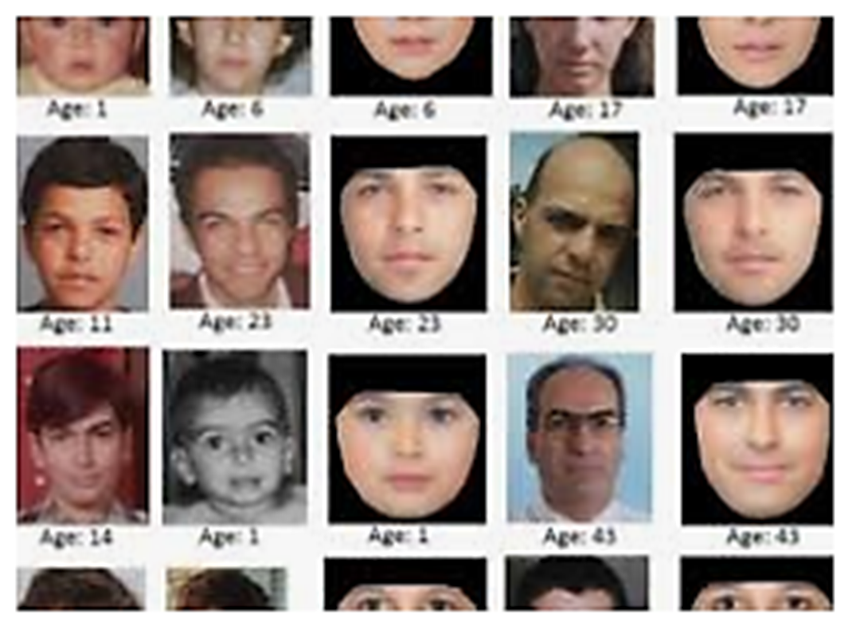

Missing Persons, Brittany Alert, Silver Alert & Amber Alert
NMLEA Accreditation: NM250004

Slide 2
Objectives
Identify the functions of the NM Missing Persons Clearinghouse
Identify the procedures for conducting a basic missing persons investigation
Identify the procedures for notifying appropriate organizations of a missing person
Identify procedures for filing Amber Alert, Brittany Alert, Silver Alert and Endangered Persons Advisory.
Identify proper forms to fill out for each missing persons category

Slide 3
NM Statutes
The Missing Persons Information and Reporting Act:
  29-15-1 through 29-15-12
  Missing persons, Children, Endangered Brittany, Silver Alerts/Advisory
  Clearinghouse function
  AMBER Alert Law:
    29-15A-1 through 29-15A-5

Slide 4
29-15-7 NMSA Missing Persons –
Law Enforcement Requirement
Law Enforcement SHALL accept without delay/exception a report of missing person
Shall, within two hours start an investigation (This begins the time we receive the initial call from dispatch)
Provide all info to the clearinghouse
Enter name of the missing into clearinghouse/NCIC
Determine if the person is endangered & notify DPS

Slide 5
29-15-7 NMSA Missing Persons –Law Enforcement Requirement
Obtain follow-up information as soon as possible & enter pertinent info into NCIC
Enter detailed information regarding unidentified remains into NCIC
Clearinghouse may already have the info

Slide 6

29-15-3 NMSA
“The Clearinghouse”
Central repository of information regarding missing persons
Created and maintained by DPS
  DPS Law Enforcement Records Bureau
  Collect, process, maintain & disseminate records on missing persons
  Compile stats on missing persons
  Provide training on missing persons
  Connected to NCIC

Slide 7
Procedures
Each agency should have their own procedures for conducting a missing persons investigation.
Recommended procedures:
  Telecommunications personnel who receive incoming reports concerning missing/endangered persons shall immediately, or as soon as practical:
  a. Contact an officer/supervisor or criminal agent/supervisor to inform them of the incident.

Slide 8
Procedures
  b. Obtain sufficient information from the reporting party to broadcast a “Be on the Lookout” (BOLO) alerting other officers about the circumstances of the adult/child disappearance.

Slide 9
Procedures
Law enforcement personnel:
  Immediately begin an investigation
    Obtain identification, clothing description, last known location, distinguishing marks other pertinent information and report for BOLO
    Provide summary of circumstances to
      Intra-agency
      Inter-agency
      FBI Duty Agent – (505) 889-1300

Slide 10
Procedures
Collect all available information to complete Missing Persons Clearinghouse report form MPCH
Treat areas of interest as potential crime scenes
Evaluate and determine if additional resources are needed i.e. supervisor, crime scene team, etc.
Fax notify appropriate personal for entry of information into NCIC & ensure MPCH form sent to NMDPS

Slide 11


Procedures
Refer to Missing Persons Investigative Checklist to ensure pertinent criteria is met
In the event it is determined that person is missing under suspicious circumstances or endangered, complete Endangered Person Advisory report form and send to DPS Clearinghouse
  Consider age, health, mental or physical disability, environment/weather or with a dangerous person when determining “endangered”

Slide 12
Procedures
Consider any information available that may be beneficial to public to assist in locating the missing person
Immediately enter into NCIC and NMCH
Contact State Police to coordinate the issuance of an Endangered Persons Advisory
Evaluate whether the information warrants a search of a given area
Contact State Police to coordinate large scale searches

Slide 13
  Upon receiving a report of a missing/runaway child, within 24 hours notify the State Registrar and submit a Birth Certificate Flag Request form to NM Vital records
  Provide Dental Record Release form to custodian or immediate family member to sign
  Maintain contact with family and keep them informed
  Update NCIC and MPCH with any new information ASAP within 48 hours
Procedures

Slide 14
Procedures
  Immediately after missing person is located, request entry cleared from NCIC,
    remove birth certificate flag if applicable using Birth Certificate Flag Cancellation Request form
    Follow up investigations to determine if other criminal activity contributed to the disappearance i.e., child abuse, etc.

Slide 15

Procedures
Endangered Person
Missing child <13
Out of safety zone for age, developmental stage or mental/physical condition
Diminished mental capacity or suicidal tendencies
Prescription dependent

Slide 16
Endangered Person
Potential foul play or sexual exploitation
In a life-threatening situation
Absent from home for 24 hours
With others considered dangerous
Absent inconsistent with normal patterns
Procedures

Slide 17
Procedures
  Immediately request entry of information into NCIC
  Fill out Endangered Person Advisory Report form and forward to MPCH
  Follow the procedures listed above
  Contact State Police
  State Police will determine if conditions are met and issue Endangered Person Advisory

Slide 18
When the endangered person is located, immediately notify State Police
Only the State Police can remove an Endangered Person Advisory.
Immediately request removal from NCIC and send information the MPCH.
Procedures

Slide 19

Procedures
Amber Alerts
Age 17 or less
Evidence child abduction
Reason to believe child is in imminent danger
Specific information available about child or abductor to assist in expedient end to abduction

Slide 20
Please see video in course materials
24-0014

Slide 21


Slide 22
Immediately request entry of information into NCIC and MPCH
Notify authorized requester of Amber Alert System (in most cases….State Police)
The authorized requestor will determine if the request meets stringent criteria and an Amber Alert may or may not be approved.
Amber Alerts are sent out region wide following existing protocol.
Procedures

Slide 23
When the child is located, immediately notify the authorized requestor.
Only the authorized requestor can remove and Amber Alert.
Immediately request removal from NCIC and send information the MPCH.
Procedures

Slide 24

Procedures
  Silver Alert
  Missing person whose whereabouts are unknown to the custodian or immediate family member
  Age 50 or older
  Clear indication that person has irreversible deterioration of intellectual faculties (Alzheimer’s, dementia, other degenerative brain disorder or brain injury)

Slide 25
Immediately request entry of information into NCIC and MPCH
Notify State Police for request for issuance of Silver Alert
The State Police PIO will determine if the request meets criteria and a Silver Alert may or may not be approved.
Silver Alerts are sent out region wide following existing protocol.
Procedures

Slide 26
When the person is located, immediately notify State Police
Only State Police can remove a Silver Alert.
Immediately request removal from NCIC and send information the MPCH.
Procedures

Slide 27
  Brittany Alerts
  Missing person whose whereabouts are unknown
  Clear indication of developmental disability
  Person’s health or safety at risk

Slide 28
Procedures
  Immediately request entry of information into NCIC and MPCH
  Notify State Police for request for issuance of Brittany Alert
  The State Police PIO will determine if the request meets criteria and a Brittany Alert may or may not be approved.
  Brittany Alerts are sent out region wide following existing protocol.

Slide 29
Procedures
When the person is located, immediately notify State Police
Only State Police can remove an Brittany Alert.
Immediately request removal from NCIC and send information the MPCH.

Slide 30
Unidentified Bodies
Agencies are required to enter all information about unidentified bodies found in their jurisdiction into NCIC and MPCH
Include all available identifying features and description of body and clothing, jewelry etc.

Slide 31
Review MPCH Forms

Slide 32
Important Contacts
NM Missing Person’s Clearinghouse
  1-800-457-3463/505-827-9026
  Fax: 505-827-3399
  Email: dps.missingperson@state.nm.us
  FBI Duty Agent : 505-889-1300
  NM Vital Records/State Registrar
    1-866-534-0051/505-827-0121
    Fax: 505-827-1751

