Slide 1
Tourniquet & Trauma Kit (NM240015)
New Mexico Law Enforcement Academy Annual In-Service Training Curriculum 2024

Slide 2
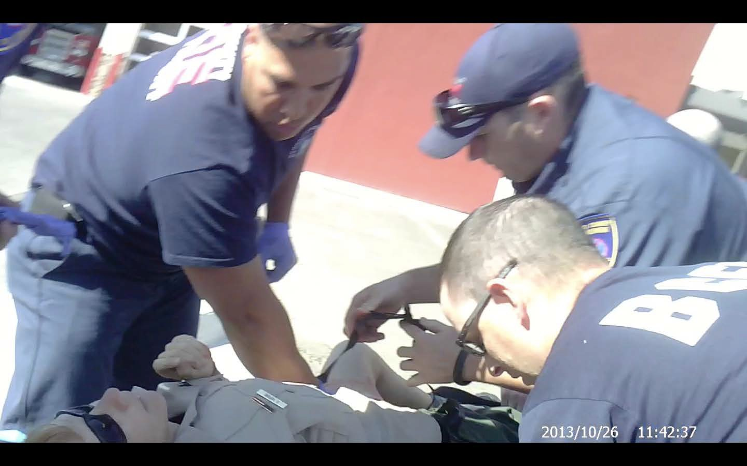
BCSO Deputy Robin Hopkins would not be here today without the ability to immediately control her blood loss.

Slide 3
SAVE A LIFE
STOP THE BLEED® Course American College of Surgeons
Copyright © 2019 American College of Surgeons
Version 2
BLEEDINGCONTROL.ORG STOPTHEBLEED.ORG
STOP THE BLEED® is a registered trademark of the U.S. Department of Defense

Slide 4
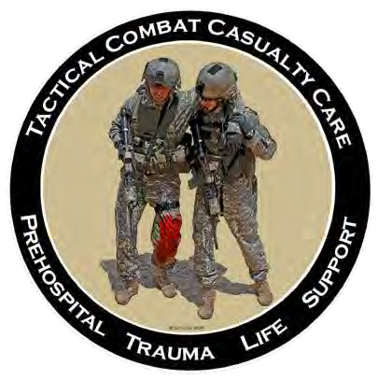
Stop the Bleed® is a collaborative effort by:
The Hartford Consensus Group
The American College of Surgeons
Committee on Trauma
The Committee on Tactical Combat
Casualty Care
The National Association of
Emergency Medical Technicians
< >

Slide 5
WARNING! Some of the images shown during this presentation
are graphic and may be disturbing to some people.

Slide 6
Why Do I Need This Training?
The #1 cause of preventable
death
after injury is bleeding.

Slide 7
Where Can I Use This Training?

Slide 8
Goals
1. Identify
2. Stop the Bleed
Recognize life-threatening
bleeding
Take steps to STOP THE BLEEDING
Pressure
Packing
Tourniquets

Slide 9
Personal Safety
YOUR safety is YOUR first priority
If you are injured, you cannot help others
Help others only when it’s safe to do so
If the situation changes or becomes unsafe:
Stop
Move to safety
If you can, take the victim with you

Slide 10
Personal Safety
YOUR safety is YOUR first priority
Wear gloves if you can
If you get blood on you, be sure to clean any part of your body that the blood has touched
Tell a health care provider that you got blood on you, and follow his or her direction

Slide 11
ABCs of Bleeding Control
A Alert 911 B Bleeding C Compress

Slide 12
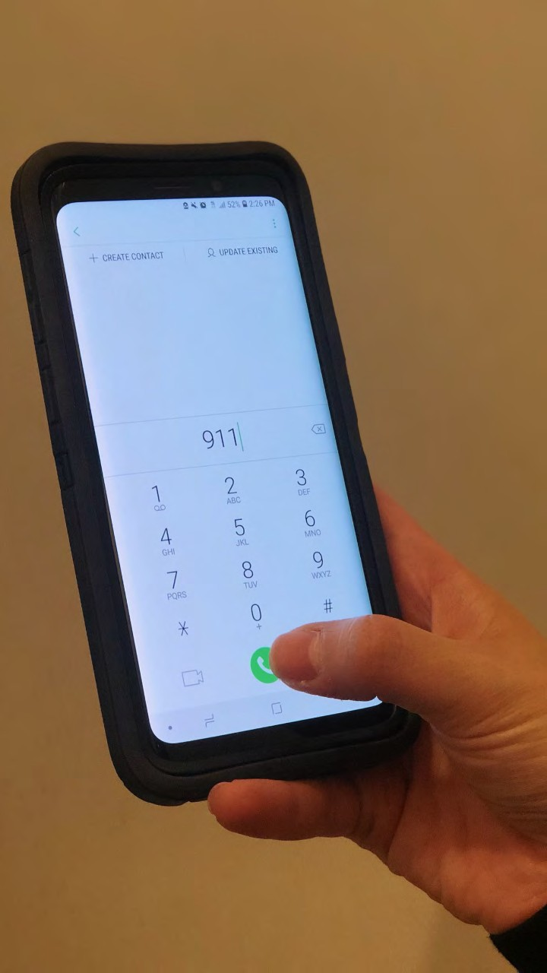
ABCs of Bleeding Control
A Alert 911 B Bleeding C Compress

Slide 13
ABCs of Bleeding Control
A Alert 911
Call 911
Know your location
Follow instructions provided by 911 operator

Slide 14
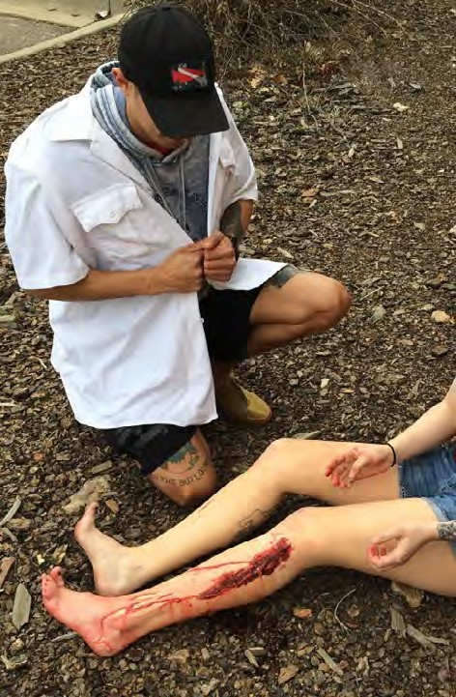
ABCs of Bleeding Control
A Alert 911 B Bleeding C Compress

Slide 15
ABCs of Bleeding Control
B Bleeding
Find source of bleeding
Look for:
Continuous bleeding
Large-volume bleeding
Pooling of blood

Slide 16
ABCs of Bleeding Control
B Bleeding
There may be multiple places the victim is bleeding
Clothing may also hide life-threatening bleeding

Slide 17
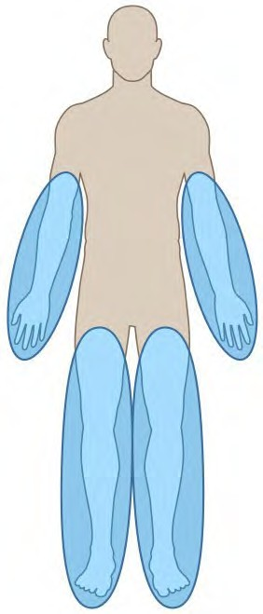
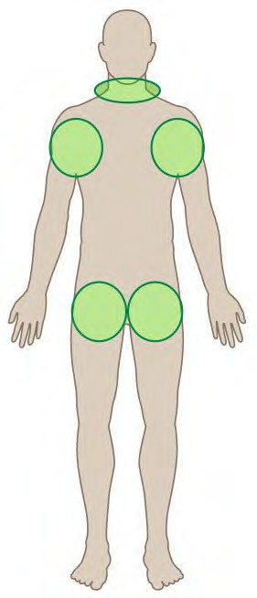
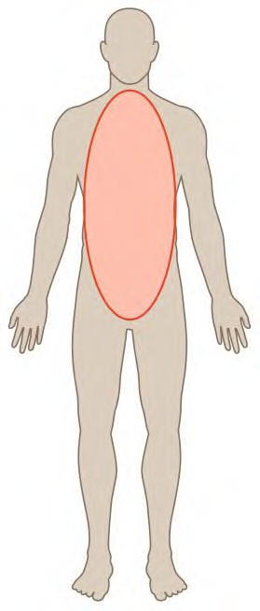
ABCs of Bleeding Control
B Bleeding
Arms and legs
Neck, armpits, and groin
Body

Slide 18
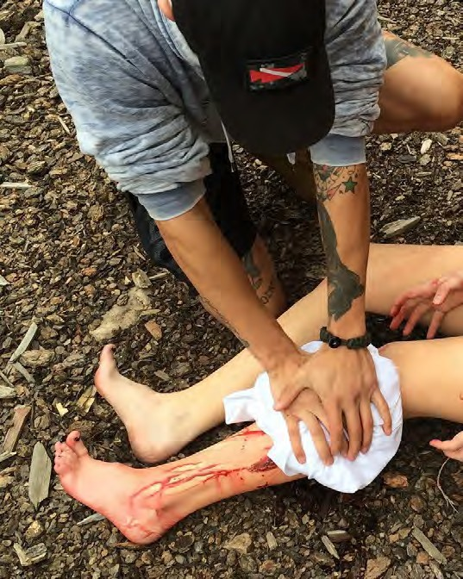
ABCs of Bleeding Control
Alert 911
Bleeding
Compress - Pressure

Slide 19
ABCs of Bleeding Control
C Compress - Pressure
Apply direct pressure to wound
Focus on the location of the bleeding
Use just enough gauze or cloth to cover injury
If pressure stops the bleeding, keep pressure on wound until help arrives

Slide 20
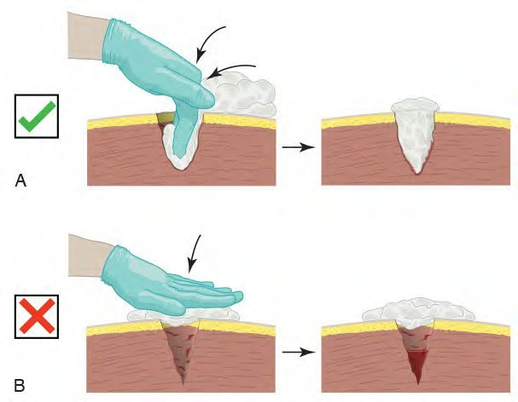
ABCs of Bleeding Control
C Compress - Packing
For large wounds, superficial pressure is not effective
If bleeding is from a deep wound, pack gauze tightly into the wound until it stops the bleeding; hold pressure until help arrives
Stop the Bleed Course v. 2.0
Introduction | A-Alert | B-Bleeding | C-
Compression |

Slide 21
ABCs of Bleeding Control
C Compress - Packing
Arms and legs
Neck, armpits, and groin
Body
Stop the Bleed Course v. 2.0

Slide 22
ABCs of Bleeding Control
C Compress - Tourniquet
Apply 2 to 3 inches above wound
Do not place over the elbow or knee
Tighten tourniquet until bleeding stops
Do NOT remove the tourniquet
Stop the Bleed Course v. 2.0

Slide 23
ABCs of Bleeding Control
C Compress - Tourniquet
Can apply to others or on yourself
Can be applied over clothes
Tourniquets HURT
A second tourniquet may be required to stop the bleeding
Stop the Bleed Course v. 2.0

Slide 24
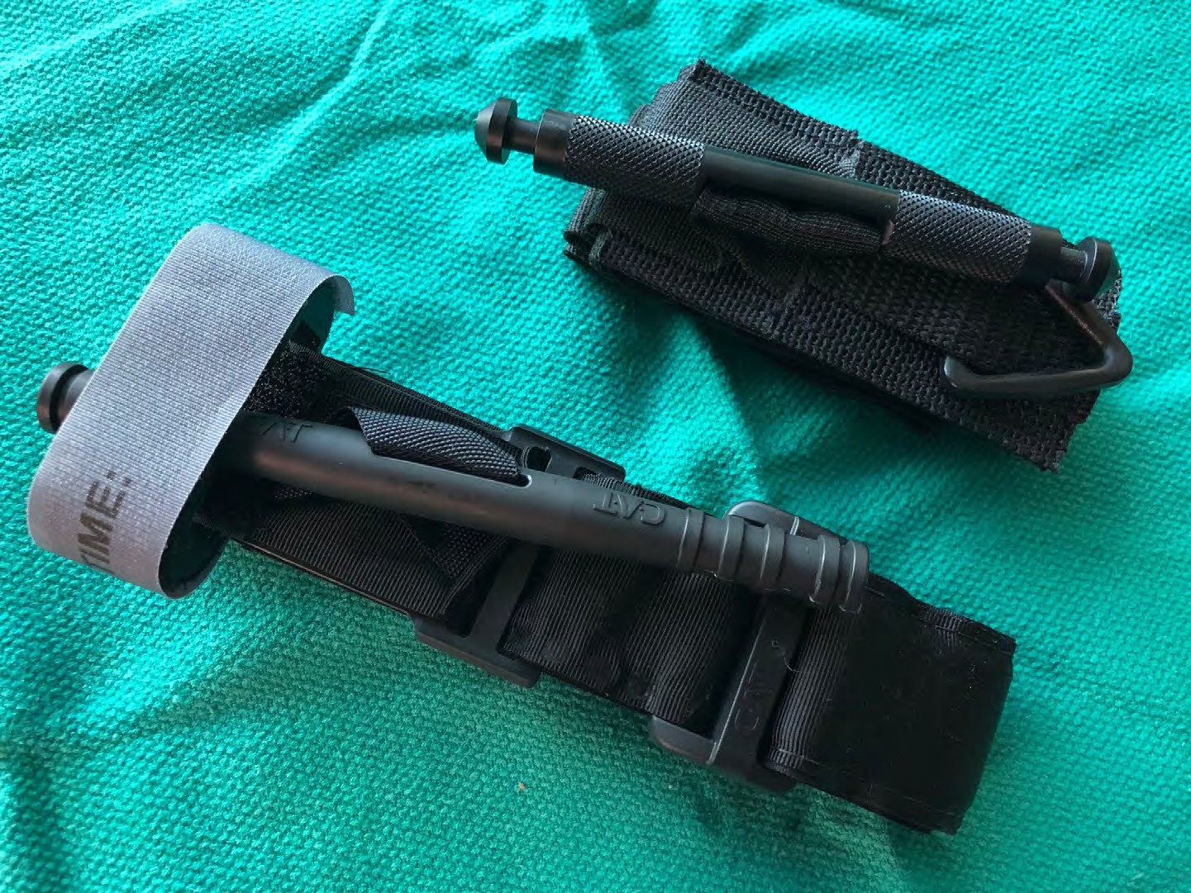
ABCs of Bleeding Control
SOFT-T
CAT
Stop the Bleed Course v. 2.0

Slide 25
Bleeding control in children
In all but the extremely young child, the same tourniquet used for adults can be used in children.
For the infant or very small child (tourniquet too big), direct pressure on the wound as described previously will work in virtually all cases.
For large, deep wounds, wound packing can be performed in children just as in adults using the same technique as described previously.
Stop the Bleed Course v. 2.0
Introduction | A-Alert | B-Bleeding | C-Compression |

Slide 26
FAQs
Impaled objects?
Improvised tourniquets?
Loss of arm or leg?
Pain?
Other questions?

Slide 27
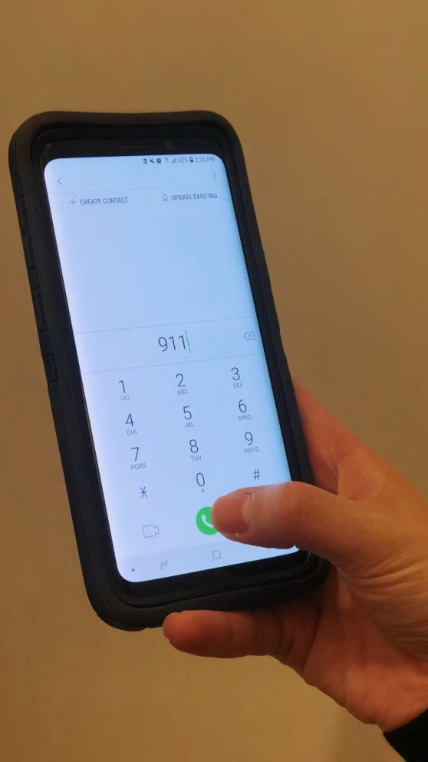
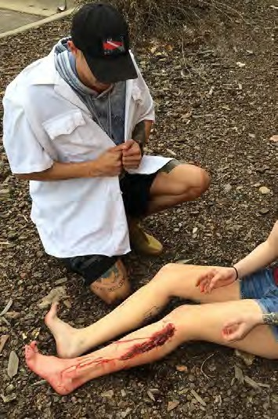
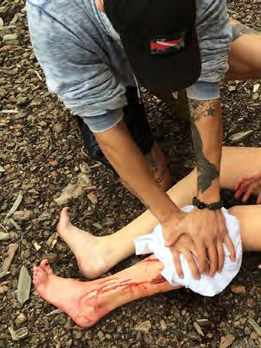
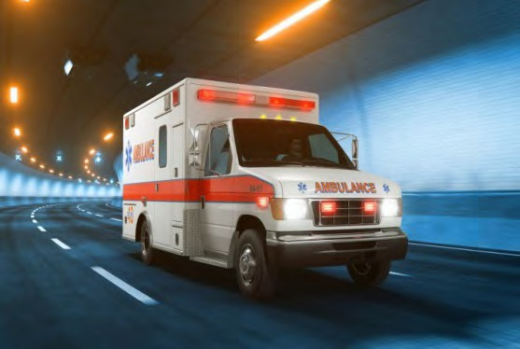
Summary
Personal safety A Alert 911
B Find bleeding C Compress with
pressure and/or packing C Compress with a
tourniquet
Wait for help to arrive

Slide 28
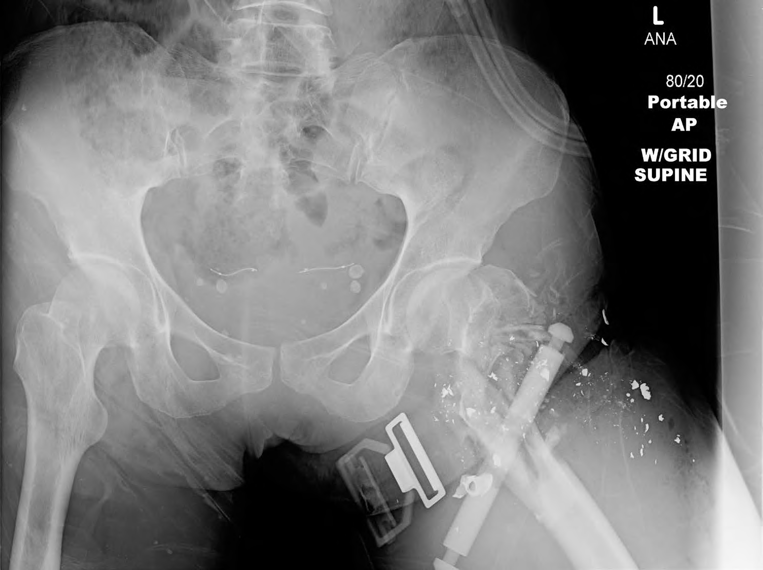
BCSO Deputy Robin Hopkins Pre-Op X-Ray

Slide 29
For more information:
BLEEDINGCONTROL.ORG
STOPTHEBLEED.ORG
Stop the Bleed Course v. 2.0

Slide 30
The only thing more tragic than a death… is a death that could have been prevented.
Stop the Bleed Course v. 2.0

