Slide 1
Domestic Violence and Police Response
police officer training

Slide 2
INSTRUCTIONAL GOALs
Provide the students with basic understanding of the New Mexico statutes regarding domestic violence
Provide statistics and officer safety and survival considerations during domestic violence calls for service
Recognize signs and symptoms of non-lethal strangulation.

Slide 3
INSTRUCTIONAL OBJECTIVES:
Know the different types of orders of protection
Know the elements of criminal damage to property or deprivation of property against a household member (30-3-18)
Know an officer's responsibilities as described in dual arrest (40-13-1.1)
Know the changes to the stalking statute as it applies to domestic violence (30-3A-3)

Slide 4
INSTRUCTIONAL OBJECTIVES:
Know the 4 key indicators associated with domestic violence calls for service wherein there is a 50% likelihood that officers will be assaulted.
Know the key safety considerations for officer safety and survival during domestic violence calls for service.
Understand the concept of a trauma informed interview of the victim/ victims of domestic violence.
Know the New Mexico state laws governing domestic violence investigations as well as case law associated with domestic violence crime.

Slide 5
INTRODUCTION
Domestic violence calls involve crimes between people with complex relationship issues, making the investigation of these crimes difficult for responding officers.
Domestic violence results in nearly 2,000 murders annually in the United States and is the most common violent crime encountered by police.
46% of reported homicides of females in NM were committed by their intimate partner

Slide 6
INTRODUCTION
This course will focus on officer safety and survival during domestic violence calls for service and strategies for facing violent assaults by DV batterers, who may well have already decided that he/she will assault officers before they arrive at the crime scene.
Experts who study domestic violence relate that having a departmental domestic violence policing strategy should include a thorough investigation and photographic evidence, identifying the “predominant aggressor,” consistent and repeated enforcement of the law and an unyielding efforts to get a victim of domestic violence to accept help.

Slide 7
https://www.theiacp.org/resources/video/the-crime-of-domestic-violence-roll-call-video

Slide 8
INVISIBILITY of Domestic violence
-Usually occurs behind closed doors
-Usually- no witnesses aside from children
-Not often reported
-Often concealed from relatives, coworkers, friends, social workers
-Both victims and witnesses try to minimize or ignore the violence
-Offenders often successfully conceal, deny, or rationalize the violence

Slide 9
https://www.krqe.com/news/crime/albuquerque-police-recalls-violent-holiday-weekend/

Slide 10
Officer frustration in dealing with DV victim behaviors
Victim refusal to cooperate with the investigation.
Recanting statements.
Refusing to testify.
Refusing to end the relationship with the batterer.
DV victims more likely to display these behaviors than victims of other crimes.

Slide 11
Additional challenges / barriers involving DV calls
Deaf or hearing diminished individuals.
Gay, lesbian, transgender, bisexual, or gender non-conforming individuals
Individuals with physical or cognitive disabilities.
Older adults
Non-English speakers (immigrants)

Slide 12
Why do people commit domestic violence?

Slide 13
abusive people believe their own feelings and needs should be the priority in the relationship.
abuse is a learned behavior – and it is also a choice to abuse.
domestic violence stems from a desire to gain and maintain power and control over an intimate partner.
tactics of abuse may be aimed at dismantling equality in the relationship in order to make their partners feel less valuable and undeserving of respect.

Slide 14
Why do people stay in dv relationships?

Slide 15
Reasons for DV victim non-cooperation
Financial dependence on the batterer – victim financially dependent – home & vehicles in batterer’s name
Social dependence on the batterer – victim isolation by batterer –withdrawal from family & friends.
Religious, family, or cultural norms – can be viewed as a sin to leave a marriage even if abusive by some religions.
Legal dangers & repercussions – child custody / property

Slide 16
Non-cooperation cont.
Told by batterers the violence is their fault and it would stop if they behaved appropriately.
They may not recognize their partner’s behaviors are abnormal or abusive
Fear of retaliation
Love

Slide 17
Why is there a fear of retaliation?
According to 2021 Statistics out of apd- 20 percent of all of their homicides were domestic violence related
Loss of control on the part of the suspect

Slide 18
Crazy exes
Some people do not realize they are in a dv relationship or that it is not normal

Slide 19
Cycle of violence
He/she isn’t always like this

Slide 20
CYCLE of violence
PHASE I- Tension building
Can last hours, months, years
Victim describes as “walking on eggshells”
Minor outbursts and edginess from soon-to-be aggressor
Victim might withdraw or try extra hard to be compliant/nurturing to avoid confrontation
Futile due to unrealistic demands

Slide 21
Cycle of violence
PHASE II- ACUTE BATTERING
Aggressor explodes- convinced themselves that violence is justified
Pets/property might be destroyed
Police normally are called in this phase
Aggressor is angry, victim is often fearful
Victim may even consciously provoke the attack to get it over with

Slide 22
Cycle of violence
PHASE III- HONEYMOON
Loving period when the aggressor expresses regret about damages and injury
Apologizes and attempts to comfort the victim
Aggressor is loving. It may be the only time he/she is good to the victim

Slide 23
Cyclical behavior makes it difficult to leave, but if victims do leave they are not as safe as we assume

Slide 25
Physical dangers of leaving
DV victims at greatest risk of being murdered in the first couple years after leaving their abusers
Stalking often occurs or escalates after victim leaves batterer
Leaving the batterer usually does not end the abuse, harassment and living in fear
Leaving the batterer and assisting the police can be among the most dangerous things the victim can do

Slide 26
Nm case IN THE NEWS
https://www.lcsun-news.com/videos/news/crime/2022/09/20/forghedaboudit-chef-bob-yacone-charged-murder-after-shootout-police/8067200001/

Slide 27
Though we ultimately want the victim and aggressor to separate for safety, we need to realize it is a dangerous process-not a split-second solution

Slide 28
DANGER TO OFFICERS

Slide 30
How dangerous are DV calls to officer safety?
Averaging FBI statistics from 1980 – 2006 an average of 4,194 officer assaults and 6 officer murders annually in the U.S. from domestic violence calls.
Four recent studies revealed that 46% of officers assaulted at dv calls received an injury requiring medical treatment.

Slide 31
Predicting assaults at DV calls
FOUR characteristics were found to predict whether an officer assault occurred
Batterer unemployed
Batterer has damaged property during the incident
Batterer resides with the DV victim
Batterer displays hostile demeanor toward the officers upon arrival
With those factors, there was a 1 in 4 chance that the batterer would assault responding officers
Without those factors, odds of attack less than 1 in 2,000

Slide 32
Lethal force assaults on officers
2008 study examined firearms assaults against officers at DV calls to determine the characteristics of these calls and what could increase officer survival.
FBI data showed the “typical” firearms assault against a law enforcement officer most often involves a younger male assailant (usually age 15 – 35) with a lengthy criminal record.
A handgun is most often used and most often opens fire at the point of arrest or bodily search and were less than 15 feet away from each other when the shootout began.

Slide 33
Domestic violence calls differ in firearms assaults on officers
DV shootouts more likely to involve older male assailants (30’s, 40’s, or older).
May or may not have a criminal history.
Armed with a rifle or a shotgun.
Half of firearms assaults began very shortly upon officers’ arrival with assailant firing from the front door of the residence or laying ambush outside of the home.
In the majority of these firearms assaults, the officers had not entered the residence or even made contact with the batterer when they opened fire.
Half of the shootings began at a distance of 50 feet.

Slide 35
Why are dv calls SO dangerous for l.e?

Slide 36
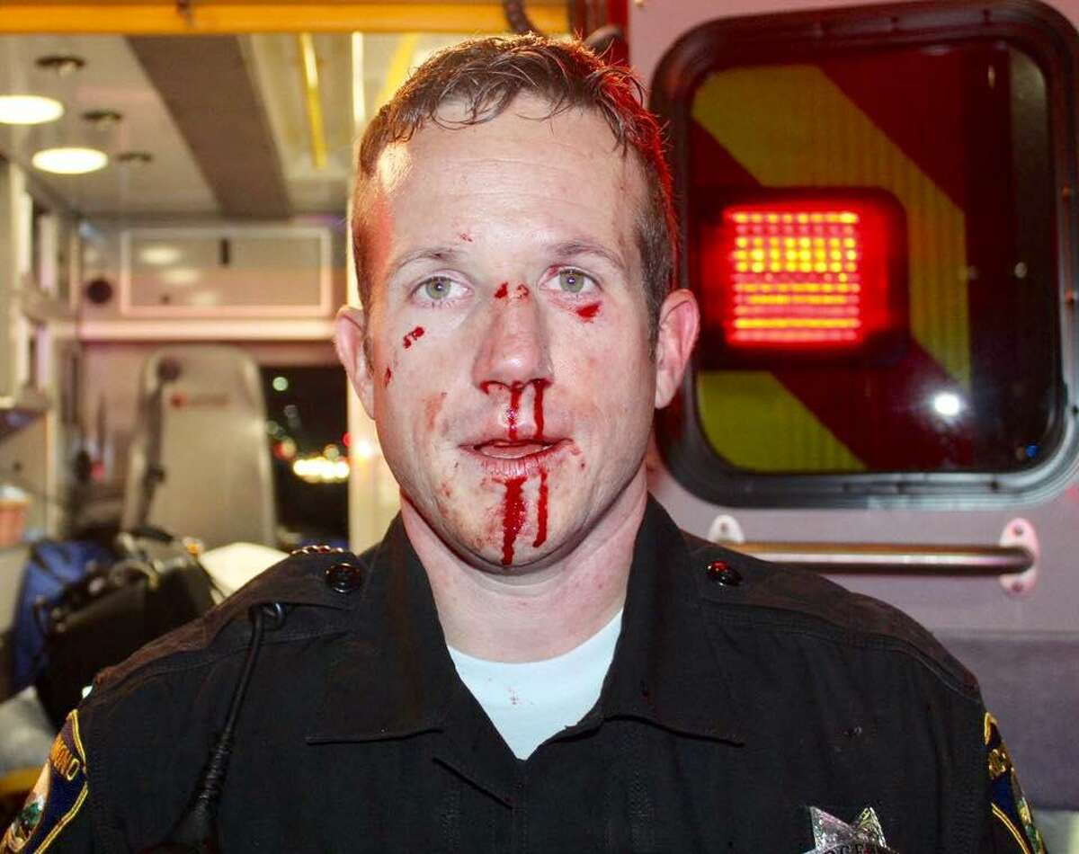
dangers
Environmental advantage by suspect
Highly emotionally charged
Access to weapons
Other parties involved
Rush in

Slide 37
Factors associated with officer survival during DV assaults
Wearing body armor
Distance between the officer and the shooter
Returning controlled accurate fire
A recent study showed that 225 officers that had been fired upon, that 14% were killed, anther 43% received survivable bullet wounds and another 43% survived without serious injury.

Slide 38
6 out of 10 officers never recognized an oncoming violent assault and 36% of the officers that were killed during a violent assault were not wearing their body armor.
An officer on a DV call should request and wait for backup and “slow down” their response if possible.
An officer should maintain their tactical advantage at all times and further avoid poor tactical positioning during a DV call.

Slide 40
When responding try to approach in a safe manner with notice of avenues of ingress and egress.
Take note of anything you see or hear that might be relevant to safety or your case
When you make contact, separate the parties for safety and investigative purposes
Always try to identify the “dominant aggressor” (bully/batterer) at a DV call.

Slide 41
Trauma informed interviews of the victim(s) should be conducted by the officer utilizing compassion and care for detailing first the trauma suffered by the victim(s) and then seeking the additional facts of case after EMS has been called and other immediate needs provided i.e., water, warmth, clothing etc.
Remember to pull 911 calls that occur before the start of the official interview(s) as they will stand as non-testimonial evidence (Crawford / Davis vs. State of Washington) , as those calls are not violation of the confrontation clause of the U.S. Constitution per the supreme court of the united states (SCOTUS).

Slide 42
OPEN ENDED QUESTIONS
"Can you tell me what happened?"
"Can you remember anything about the event?"
"Do you remember what you were thinking or feeling at that point?"
"What do you remember saying and doing at that point?"

Slide 43
Example 1 - rather than asking a domestic violence victim “did he strangle you”, instead ask, “did he put his hands on your neck or body?", "were you able to breathe at all?".
Example 2- rather than asking a victim of intimate partner violence or stalking, ”has he/SHE ever abused you or beat you?", instead ask, “can you tell me about the times he/she hurt you or made you feel afraid?"

Slide 44
Be wary of manipulation

Slide 45
DV Crime Scene Photography- Document
Entire crime scene
Evidence
1. damaged property, damaged torn or ripped clothing
2. crying children, so that the prosecutor, judge and jury can see what you saw

Slide 46
Studies in Indiana found that compared to DV cases with photographic evidence were 129% more likely to result in a plea of guilty by the batterer
76% more likely to result in a conviction should the case go to trial.
This study also showed that cases with photographic evidence was 205% more likely to result in a sentence of incarceration.

Slide 47
A Phoenix police department study showed that only with the use of a body worn camera as video evidence at trial resulted in a 389% more likely to result in a conviction.
Recent studies show that mandatory arrest policies for dv offenses have shown to reduce dv homicides by 35%.

Slide 48
Some police departments in other states surveil the most dangerous batterers and utilize “threat assessment surveys” as a component of their DV investigations.
Threat assessment tools can determine the level posed by some batterers based on past background and behavior, to include utilization access to firearms to predict future violence, which could have an effect on new acts of violence and prevent homicide

Slide 49
De-Escalation
During a domestic violence incident an officer can engage in de-escalation,“the use of words, actions and techniques to defuse a heightened emotional state, to facilitate calm and rational interaction and to gain suspect compliance.”
The officer on a DV call can use de-escalation unless: it is unsafe or not feasible to do so.
The officer should remember that if there are not exigent circumstances, one should always de-escalate.
There has been case law in relation to officer-created jeopardy.

Slide 50
The Six Most Common Areas of Officer Liability in
Domestic Violence Cases:
Failure to take proper actions to protect citizens
Failure to appropriately enforce a court order protecting a victim of domestic abuse
Failure to respond at all or in a timely manner
Failure to provide information to a victim as required by law
Arresting a citizen without establishing probable cause
Exhibiting a pattern of differential treatment or application of the law to domestic abuse cases

Slide 51
Failure to Arrest or Restrain: If victims can show that officer stood by when person were committing, about to commit, or threatening to commit violent crimes, some courts have held the officer/agency liable.
Ross v. Gaston
Jones V. County of Herkimer
Baker v. City of New York
* All the above are DV homicide cases

Slide 52
History of Violence of Against Women Act
The Violence against Women Act of 1994 (VAWA)
The first comprehensive federal legislation responding to violence against women was introduced in 1990. During the 103rd congress the VAWA was signed into law in august 1994 as part of the violent crime control and law enforcement act of 1994 by President Bill Clinton. The provisions of the VAWA expired in 2000.
This was considered the first vital stem in the nation’s efforts to treat domestic violence as a serious problem.

Slide 53
Working together-resources

Slide 54
VAWA summary
New grant programs encouraging states to address domestic violence and sexual assault including:
Law enforcement prosecution grants
Grants to encourage arrest
Rural domestic violence and child abuse enforcement grants
The national domestic violence hotline

Slide 55
VAWA Summary CONT.
Grants to battered women’s shelters
Full faith and credit—requires all state, tribal courts and courts in U.S. Territories to accord full faith and credit to orders of protection issued from other jurisdictions. Provides for mandatory nationwide enforcement of orders of protection for victims of crimes against women.

Slide 56
VAWA has been reauthorized and updated several times
Most recently was March of 2022
Reauthorized grant programs
Expansion of special criminal jurisdiction of tribal courts to cover non-Native perpetrators of sexual assault, child abuse, stalking, sex trafficking, and assaults on tribal law enforcement officers on tribal lands

Slide 57
RESULTS
Increased services and support in underserved communities
Strengthening evidence-based practices
Improving healthcare system response to DV and sexual assault

Slide 58
Statute
Family Violence protection Act- Chapter 40, Article 13

Slide 59
“domestic abuse”:
Means an incident of stalking or sexual assault whether committed by a household member
Means an incident by a household member against another household member consisting of or resulting in:
-Physical harm
-Severe emotional distress
-Bodily injury or assault
-A threat causing imminent fear of bodily injury by a household member
-Criminal trespass
-Criminal damage to property
-Repeatedly driving by a residence or workplace
-Telephone harassment
-Harassment
-Harm or threatened harm to children as set forth in this paragraph
-Does not mean the use of force in self-defense or the defense of another

Slide 60
“Household member" means a spouse, former spouse, parent, present or former stepparent, present or former parent in-law, grandparent, grandparent-in-law, a co-parent of a child or a person with whom a person has had a continuing personal relationship. Cohabitation is not necessary to be deemed a household member for the purposes of the crimes against household members act;
"Continuing personal relationship" means a dating or intimate relationship;
NMSA 30-3-11

Slide 61
ORDERS OF PROTECTION
Mutual order of protection” means an order of protection that includes provisions that protect both parties
“Order of protection” means an injunction, or a restraining or other court order granted for the protection of a victim of domestic abuse;
“Protected party” means a person protected by an order of protection; and
“Restrained party” means a person who is restrained who is restrained by an order of protection

Slide 62
Ex parte emergency orders of Protections (40-13-3.2)
L.E.O. sworn statement to court in person/phone/email/fax through district court
Emergency order of protection and the court finds reasonable grounds to believe that the alleged victim or the alleged victim’s child is in immediate danger of domestic abuse following an incident of domestic abuse. The written statement shall include the location and telephone number of the alleged perpetrator, if known.

Slide 63
A Law enforcement officer who receives an emergency order of protection, whether in writing, by telephone or by facsimile transmission, from the court shall:
If possible, immediately serve a signed copy or the order on the restrained party and complete the appropriate affidavit of service
Immediately provide the protected party with a signed copy of the order
Provide the original order to the court by the close of business on the next judicial day.

Slide 64
The court may grant the following relief in an emergency order of protection upon a probable cause finding that domestic abuse has occurred:
BAR the restrained party from threatening to commit or committing acts of domestic abuse against the protected party or any designated household members;
BAR the restrained party from any contact with the protected party, including harassing, telephoning, contacting or otherwise communicating with the protected party; and
Grant temporary custody of any minor child in common with the parties to the protected party, if necessary.

Slide 65
A district judge shall be available as determined by each judicial district to hear petitions for emergency orders of protection.
An emergency order of protection expires seventy-two hours after issuance or at the end of the next judicial day, whichever time is latest. The expiration date shall be clearly stated on the emergency order of protection.
A person may appeal the issuance of an emergency order of protection to the court that issued the order. An appeal may be heard as soon as the judicial day following the issuance of the order.

Slide 66
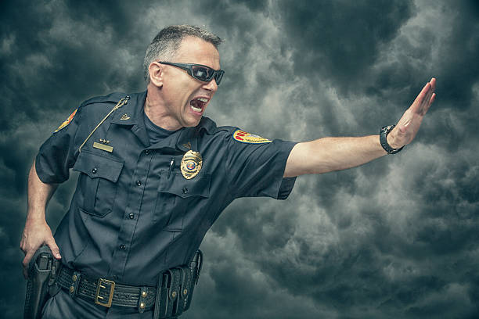
Emergency orders of protection are enforceable in the same manner as other orders of protection issued pursuant to the provisions of family violence protection act.

Slide 67
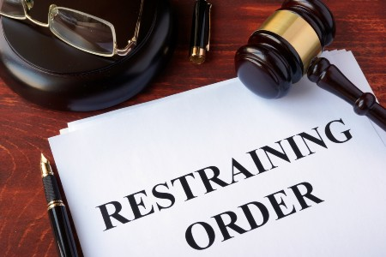
Temporary order of protection (40-13-4)
Petition is filed by victim in District Court
Upon a proper petition, a district court may issue a temporary order of protection that is based upon the same incident of domestic abuse that was alleged in an emergency order of protection.

Slide 68
Order of Protection can be issued if there is probable cause to show specific facts shown by the affiant or by the petition to give the judge reason to believe that an act of domestic abuse has occurred.
A hearing will be held within ten days to question continuing the order
If notice of hearing cannot be served within seventy-two hours, the temporary order of protection shall be automatically extended for ten days.
If the court grants a temporary order of protection, it may award temporary custody and visitation of any children involved when appropriate
Except for petitions alleging stalking or sexual assault, if the court finds that the alleged perpetrator is not a household member, the court shall dismiss the petition.

Slide 69
Order of Protection
Upon finding that domestic abuse has occurred or upon stipulation of the parties, the court shall enter an order of protection ordering the restrained party to refrain from abusing the protected party or any other household member. The court shall specifically describe the acts the court has ordered the restrained party to do or refrain from doing. As a part of any order of protection, the court may:
Grant sole possession of the residence or household to the protected party during the period of the order of protection is effective or order the restrained party to provide temporary suitable alternative housing for the protect party

Slide 70
Award temporary custody of any children involved when appropriate an provide for visitation rights, child support and temporary support for the protected party on a basis that gives primary consideration to the safety of the protected party and the children.
Order that the restrained party shall not initiate contact with the protected party
Restrain a party from transferring, concealing, encumbering or otherwise disposing of the other party’s property or the joint property of the parties except in the usual course of business or for the necessities of life and require the parties to account to the court for all such transferences, encumbrances and expenditures made after the order is served or communicated to the restrained party;

Slide 71
Order the restrained party to reimburse the protected party or any other household member for expenses reasonably related to the occurrence of domestic abuse, including medical expenses, counseling expenses, the expense of seeking temporary shelter, expenses for the replacement or repair of damaged property or the expense of lost wages
Order the restrained party to participate in, at the restrained party’s expense, professional counseling programs deemed appropriate by the court, including counseling programs for perpetrators of domestic abuse, alcohol abuse or abuse of controlled substances

Slide 72
The order of protection shall contain a notice that violation of any provision of the order constitutes contempt of court and may result in a fine or imprisonment or both.
If the order of protection supersedes or alters prior orders of the court pertaining to domestic matters between the parties, the order shall say so on its face.
If an action relating to child custody or child support is pending or has concluded with entry of an order at the time the petition for an order of protection was filed, the court may enter an initial order of protection, but the portion of the order dealing with child custody or child support will then be transferred to the court that has or continues to have jurisdiction over the pending or prior custody or support action.

Slide 73
A MUTUAL ORDER OF PROTECTION shall be issued only in cases when both parties have petitioned the court and the court makes detailed findings of fact indicating that both parties acted primarily as aggressors and that neither party acted primarily in self-defense.
No order issued under the family violence protection act shall affect title to any property or allow a party to transfer, conceal, encumber or otherwise dispose of another party’s property or the joint or community property of the parties.
Either party may request a review hearing to amend an order of protection. An order of protection involving child custody or support may be modified without proof of a substantial or material change or circumstances.
An order of protection shall not be issued unless a petition or a counter petition has been filed.

Slide 74
Service of order (40-13-6)
An order of protection granted under the family violence protection act shall be filed with the clerk of the court, the order shall be filed and served without cost to the protected party.
A local law enforcement agency receiving an order of protection from the clerk the court that was issued under the family violence protection act shall have the order entered in the national crime information center’s order of protection file within seventy-two hours of receipt.

Slide 75
An order of protection granted by the court involving custody or support shall be effective for a fixed period of time not to exceed six months. The order may be extended for good cause upon motion of the protected party for an additional period of time not to exceed six months.
A peace officer shall arrest without a warrant and take into custody a restrained party whom the peace officer has probable cause to believe has violated an order of protection that is issued pursuant to the family violence protection act or entitled to full faith and credit.

Slide 76
State courts shall give full faith and credit to tribal court orders of protection and orders of protection issued by courts of other states.
A restrained party convicted of violating an order of protection granted by a court under the family violence protection act is guilty of a misdemeanor and shall be sentenced in an accordance with section 31-19-1 NMSA 1978. Upon a second or subsequent conviction, an offender shall be sentenced to a jail term of not less than seventy-two consecutive hours that shall not be suspended, deferred or taken under advisement.

Slide 77
Verification of a Protection Order
An order of protection issued in another jurisdiction is enforceable when:
The order appears to be valid
There is probable cause to believe that a violation of the order occurred in the enforcing jurisdiction
Other verification methods:
Confirmation of the order in NCIC
Confirmation through communication with the issuing agency
Review of the elements of an order in the state or local protection order registry of the issuing jurisdiction
Review of the elements of an order if previously filed with authorities in the enforcing jurisdiction

Slide 78
Be familiar with related statutes

Slide 79
Criminal damage to property of household member
Criminal damage to property of a household member consists of intentionally damaging real, personal, community or jointly owned property of a household member with the intent to intimidate, threaten or harass the household member
Whoever commits criminal damage to the property of household member is guilty of a misdemeanor, except that when the damage to the household member’s interest in the property amounts to more than one thousand dollars ($1,000), the offender is guilty of a fourth-degree felony

Slide 80
Deprivation of the property of a household member
Deprivation of the property of a household member consists of intentionally depriving a household member of the use of separate, community or jointly owned personal property of the household member with the intent to intimidate or threaten that household member
Whoever commits deprivation of the property of a household member is guilty of a misdemeanor

Slide 81
Stalking (30-3A-3)
Stalking consists of knowingly pursuing a pattern of conduct, without lawful authority, directed at a specific individual when the person intends that the pattern of conduct would place the individual in reasonable apprehension of death, bodily harm, sexual assault, confinement or restraint of the individual or another individual.
“Pattern of conduct” means two or more acts, on more than one occasion, in which the alleged stalker by an action, method, device or means directly, indirectly or through third parties, follows monitors, surveils, threatens or communicates to or about a person.

Slide 83
Stalking cont.
Whoever commits stalking is guilty of a misdemeanor. Upon a second or subsequent confliction, the offender is guilty of a fourth-degree felony.
In addition to any punishment provided pursuant to the provisions of this section, the court shall order a person convicted of stalking to participate in and complete a program of professional counseling at the person’s own expense or a domestic violence offender treatment or intervention program.

Slide 84
Aggravated stalking (30-3A-3.1)
Aggravated stalking consists of stalking perpetrated by a person:
Who knowingly violates a permanent or temporary order of protection issued by a court, except that mutual violations of such orders may constitute a defense to aggravated stalking;
In violation of a court order setting conditions of release and bond
When the person is in possession of a deadly weapon; or
When the victim is less than sixteen years of age.
Whoever commits aggravated stalking is guilty of a fourth-degree felony. Upon a second or subsequent conviction, the offender is guilty of a third-degree felony.

Slide 85
Stalking cont.
In 76% of completed and 85% of attempted intimate partner femicides, victims experienced stalking the year prior to the attacks
Identifying and intervening in stalking cases early can help prevent violence and even death

Slide 86
Dual arrests

Slide 87
Dual Arrests (40-13-1.1)
The legislature finds that domestic abuse incidents are complex and require special training on the part of law enforcement officers to respond appropriately to domestic abuse incidents.
The State of New Mexico discourages dual arrests of persons involved in incidents of domestic abuse. A law enforcement officer, in making arrests for domestic abuse, shall seek to identify and shall consider whether one of the parties acted in self-defense and identify the “primary aggressor” (bully).

Slide 88
Emergency Assistance; providing notification to victims when an alleged perpetrator is released from detention (40-13-7)
A local law enforcement officer responding to the request for assistance shall be required to take whatever steps are reasonably necessary to protect the victim from further domestic abuse, including:
Advising the victim of the remedies available under the family violence protection act; the right to file a written statement, a criminal complaint and a request for an arrest warrant; and the availability of domestic violence shelters, medical care, counseling and other services;
Upon the request of the victim, providing or arranging for transportation of the victim to a medical facility or place of shelter;

Slide 89
The jail or detention center shall make a reasonable attempt to notify the arresting law enforcement agency or officer when the alleged perpetrator is released from custody. The arresting law enforcement agency shall make a reasonable attempt to notify the victim that the alleged perpetrator is released from custody.
Any law enforcement officer responding to a request for assistance under the family violence protection act is immune from civil liability to the extent allowed by law. Any jail, detention center or law enforcement agency that makes a reasonable attempt to provide notification that an alleged perpetrator is released from custody is immune from civil liability to the extent allowed by law.

Slide 90
Entry into domestic violence safe house or shelter; search warrant
It is not a violation of section 30-22-1 or section 30-22-4 NMSA 1978 for a person who is a member, resident, employee or volunteer of or is otherwise associated with a domestic violence safe house or shelter to request that a law enforcement officer show a valid search warrant before allowing the officer to enter the domestic violence safe house or shelter. Nothing in this section shall prevent a law enforcement officer from executing a valid search warrant.
Prior to attempting to serve an arrest warrant within a domestic violence safe house or shelter, a law enforcement officer shall obtain a valid search warrant, unless exigent circumstances exist necessitating immediate entry.

Slide 91
Domestic Violence Report Review Checklist:
How was the case received?
Is the time of the call recorded (including time of incident, time of dispatch, time of arrival)?
Are the elements of the crime articulated?
What were the observations upon approach?
Is there a valid protection order in place?
Is the scene concisely described/diagramed?
Were photos taken and details recorded?
Is the relationship of the parties identified?
What is the history of the relationship? Include frequency of any violence, intimidation, and
Threats)

Slide 92
Were all witnesses interviewed and documented?
Were there children on the scene?
Was information about previous incidents documented?
Were weapons/objects used?
What was the emotional state of the victim (what did they report they were thinking and feeling)?
What evidence was collected?
Is evidence of fear articulated in the report?
Have all threats been clearly documented?
Is the use of coercion and/or force articulated?
Have all injuries (visible and non-visible) been documented? Were injuries existing or new?
Was there any property damage? Theft? Burglary?

Slide 93
Are stalking behaviors identified? (E.G,. Following, repeated calling, sending unwanted gifts)
Did the officer inquire about possible strangulation (hands, ligature, etc.)?
Did the victim report being strangled ("choked")? If so, was it described in detail?
Did the victim request/need medical attention?
Did the victim report sexual violence?
Were all spontaneous statements captured?

Slide 94
Did the officers assist the victim with safety planning?
Does the suspect have access to weapons?
Did the officer provide information about obtaining an order of protection (if laws permit)?
Did the officer(s) provide the victim with information about local service providers?
Did the officer(s) utilize a threat/risk assessment tool with the victim?

Slide 95
If both parties used force, were the proper steps taken to determine if one was in self-defense?

Slide 96
Did the officer gather comprehensive information about the suspect?
Was an arrest made?
If an arrest was not made, is a detailed explanation of the reasoning in the report?
Was the proper protocol followed if the suspect was not on the scene?
Are there any active warrants out for the suspect?
Has the suspect been the respondent to a protection order in the past?

Slide 97
What is the history of the relationship? (Include frequency of any violence, intimidation, and threats)
Were all witnesses interviewed and documented? Were weapons/objects used?
What was the emotional state of the victim (what did they report they were thinking and feeling)?
What evidence was collected?
Is evidence of fear articulated in the report?

Slide 98
Children on scene

Slide 99
Children on scene cont.
Be sure to ask age-appropriate questions
Open-ended questions
Try to speak to the child in a place they feel safe and not influenced
Be aware that in 36 % of DV incidents there are children in the home
Of those, 60% witnessed domestic violence

Slide 100
Ages infant to 5
Sleep and/or eating disruptions
Withdrawal/lack of responsiveness
Intense/pronounced separation anxiety
Inconsolable crying
Developmental regression, loss of acquired skills
Intense anxiety, worries, and/or new fears
Increased aggression and/or impulsive behavior

Slide 101
Ages 6-11
Nightmares, sleep disruptions
Aggression and difficulty with peer relationships in school
Difficulty with concentration and task completion in school
Withdrawal and/or emotional numbing
School avoidance and/or truancy

Slide 102
Ages 12-18
Antisocial behavior
School failure
Impulsive and/or reckless behavior
Substance abuse
Running away
Involvement in violent or abusive dating relationships
Depression/ANXIETY/WITHDRAWAL

Slide 103
Duty to ensure safety
Officers are tasked with making sure any juvenile dependents are safe and have basic needs met
Assist finding placement if caregivers are arrested
Departmental policy- might require cyfd referral depending on the circumstances

Slide 104
Non-lethal strangulation

Slide 105
Strangulation vs choking – what is the difference?

Slide 106
Choking:
Internal blockage of airway
“Choking” on food, candy, etc..
Allergic reactions – swollen shut
Most often accidental

Slide 107
Strangulation closure of blood vessels and air passages in the neck caused by external forces
3 types:
Manual – hands, arms, legs, knees, feet, etc..
Ligature – necklaces, shirts, panty hose, belts, etc.
Hanging (usually suicidal/accidental)

Slide 108
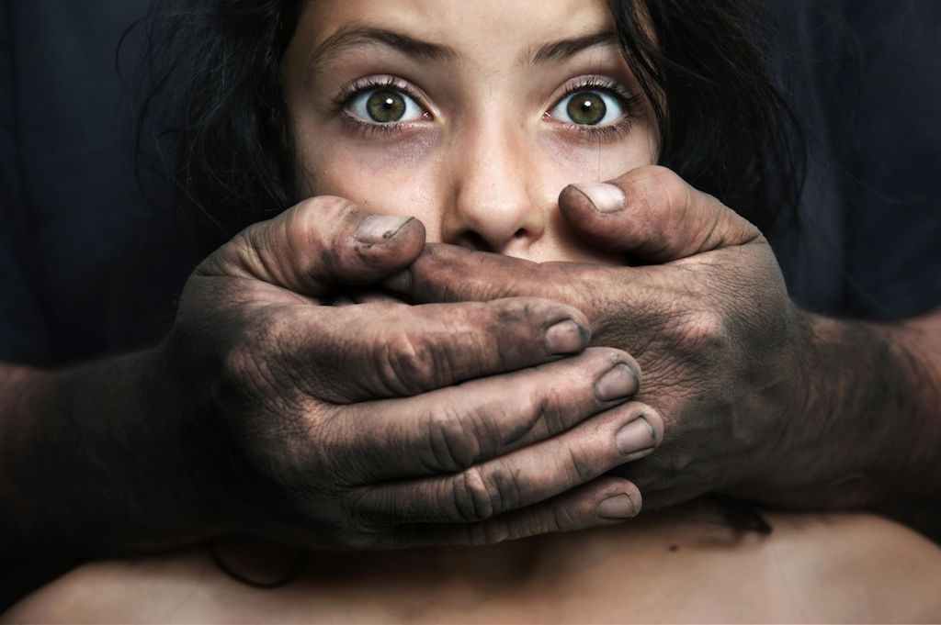
Strangulation by the Numbers Study in the Journal of Emergency Medicine
97% are manual
50% of the time children were present
67% reported NO symptoms
50% NO visible injury
35% injury TOO minor to photograph
**Huge factor in lethality

Slide 109
Death can occur later
15% injury photographed
10% - 18% DV homicides
43% of homicide victims reported prior strangulation incidents
1 in 5 experience strangulation in relationships
7x more likely to be killed
After ~50 seconds unable to “bounce-back”

Slide 110
STRANGULATION: THE MECHANICS
3-6 lbs. Pressure to pull the trigger of most handguns
20 lbs. Pressure to open soda pop can
CAROTID ARTERY: CARRIES OXYGENATED BLOOD TO THE BRAIN
11 pounds of pressure to occlude (soda can = 20 pounds)
10 seconds to unconsciousness
50 seconds of oxygen deprivation = point of no return – person can’t bounce back – reflexes to do so are gone. Brain death within 4-5 minutes

Slide 111
Carotid artery occlusion cont.
15 seconds to brain infarct (stroke)
1- 30 seconds to cardiac arrest
No Petechiae

Slide 112
Jugular Vein occlusion
Jugular Vein removes deoxygenated blood from brain
20 – 30 seconds to Petechiae
4.4 pounds of pressure to back up blood flow (unconsciousness, respiration, asphyxia)

Slide 113
DAMAGE TO LARYNX/TRACHEA/HYOID
cuts off air flow to lungs (33 lbs. pressure)
4 – 5 minutes to brain death
Usually done with 2 hands – compression to the spine
Broken hyoid – often done one handed – head extended back
Ear appears pale due to loss of blood
Cartilage death and scarring (fibrosis)

Slide 114
Talking to the victim
Summon medical aid- remember that death can occur later
Describe if ligature used
Describe how strangled
For how long?
Describe amount of force

Slide 115
What was used to strangle the victim (one hand, two hands, forearm, other body part, ligature, etc.)?
Were other weapons involved?
Did the strangulation take place from the front or behind?
Was the victim wearing jewelry?
Was the suspect wearing jewelry? Gloves?
Is the suspect right or left-handed, if known?
How long did the strangulation last? How many times was the victim strangled?
Was the victim also smothered?
Was the victim also shaken while being strangled?
Was the victim’s head pushed into a wall, floor, or other surface?

Slide 116
Did the victim attempt to protect themselves?
Did the suspect say anything to the victim before/while/after the strangulation occurred?
What was the suspect’s demeanor before, during and after the incident?
Did the victim describe what the suspect’s face looked like during the incident?
Why and how did the suspect stop strangling the victim?

Slide 117
Ask about and capture details regarding non-visible injuries that occur from strangulation
Difficulty breathing/unable to breath, hyperventilation
Raspy voice, hoarse voice, coughing, unable to speak
Trouble swallowing, painful to swallow
Neck pain
Nausea, vomiting

Slide 118
LIST CONTINUED…
Involuntary urination or defecation
Dizziness, fainting/light-headed
Headaches, head “rush”, ears ringing
Loss of consciousness
Change in mental status (disoriented, combative, memory loss, “spaced out”)

Slide 119
Ask about and document visible injuries from strangulation
Petechiae (pinpoint red spots above the area of constriction)
Hemorrhaging, bruising
Scratch marks, scrapes, abrasions
Bloody nose, broken nose
Fingernail impressions
Swelling of the neck or face
Pulled/missing hair, bumps on head
Skull fracture, concussion
Swollen tongue, swollen lips
Were there any existing (old) injuries?

Slide 120
Did you discuss the following with the victim?
The need for follow-up photos.
Receiving medical attention. Symptoms and injuries can occur days or weeks after the strangulation,
Information about local service providers.

Slide 121
TRUE OR FALSE?
It takes a lot of force to strangle someone to death

Slide 122
NM Law- STRANGULATION
FVPA, Abuse & Neglect, & Crimes Against HHM Act
SB 61 signed into law March 2018. Effective July 1, 2018.
Strangulation means the unlawful touching or application of force to another person’s neck or throat with intent to injure that person and in a manner whereby great bodily harm or death can be inflicted, the result of which impedes the person’s normal breathing or blood circulation

Slide 123
Suffocation
The unlawful touching or application of force that blocks the nose or mouth of another person with the intent:
Great bodily harm: an injury to a person which creates a high probability of death… SECTION 30-1-12A NMSA 1978
Aggravated battery against a household member (GBH): the defendant cause GBH or acted in a way that would likely result in death or GBH Section 30-3-16(C)

Slide 124
Combatting the issue
Law enforcement will not solve this issue alone- nor will it likely ever be “resolved”
Recommit our efforts
Establish a relationship with D.A. about prosecution strengths/weaknesses
Collaborate with community stakeholders

Slide 125
resources

Slide 126
NMLA DV helpline - assistance with legal representation for: DV order of protection hearings, advice and counsel on divorce, custody, housing, poverty issues facing DV victims
1-877-974-3400 or helpline@nmlegalaid.org
Monday through Friday 9am to 5pm.
No income guidelines
Funded by CVRC

Slide 127
National Domestic Violence Hotline: 1-800-799-SAFE (7233)
UNM Mental Health: 505-272-2800
AGORA NM Crisis Center: 505-277-3013
Domestic Violence Hotline: 1-800-773-3645
Child Abuse Hotline: 505-841-6100
Adult Protective Services: 1-866-654-3219 or 1-505-476-4912
New Mexico Crisis and Access Line: 855-662-7474

Slide 128
SUMMARY:
Officer(s) and first responders should be aware of the dynamic circumstances they are facing when heightened human emotions are at play in a call for service at domestic violence incidents.
First and foremost is consideration and planning for officer safety, and tactical and statistical awareness that will make these calls for service challenging.

Slide 129
REVIEW:
Once the crime scene is stabilized, parties separated and identified, the officer(s) must quickly offer and provide emergency medical services and show sincere compassion and concern first for the trauma experienced by the victim(s), be they men, women, children or members of the LGBTQ community.
Connecting the victim(s) to community victim advocates, safe homes, church and other community service providers will be essential to successfully concluding the investigation and victim(s) assistance.

Slide 130
The officer(s) must be prepared to investigate and document thoroughly a variety of crimes emanating from the domestic violence call, such as sexual assault, protection order violations, illegal possession of firearms, non-lethal strangulation and stalking. The investigation will then logically follow from understanding and addressing the trauma inflicted by the primary aggressor (batterer) and out to the essential compassionate interviews necessary to gather all the facts necessary, including the proper identifying, photographing and gathering all available evidence in order to fully document the crimes associated with domestic violence.
Officer(s) and investigators should be aware of the need for follow-up, and evidence gathering, such as photographing bruises that may take hours or days to develop and gathering additional evidence of stalking, harassment, threats, or other crimes.

Slide 131
QUesTIONS?

Slide 132
REFERENCES
Training Institute on strangulation prevention
Nm coalition against domestic violence
Nmsa
Iacp domestic violence training
New Mexico domestic violence data central depository

