Slide 1
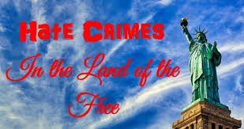
Hate Crimes
NMLEA Accreditation Number: NM220006

Slide 2
Objectives
Differentiate between a hate crime and free speech
Discuss the major SCOTUS decision on hate crimes
Identify the role of police in investigating hate crimes
Identify the importance of documenting and reporting hate crime statistics
Identify the requirements for a crime to be a hate crime
Discuss the profile of a person who commits a hate crime
Identify practice to reduce future hate crimes

Slide 3
HATE CRIMES
HISTORICAL BACKGROUND
SERIOUSNESS OF HATE CRIMES
Hate and fear have been successfully exploited by leaders for thousands of years.
Hate spreads like a brush fire and can suddenly flare up and escalate into violence.
Also, a hate crime can be further reaching and than the crime itself and can have a greater impact on the community.
Hate crimes can range from simple vandalism to genocide. A look at some historical examples will illustrate the reality of hate crimes.

Slide 4
HATE CRIMES- THE REST OF THE WORLD
Romans and Christians
In 64 A.D., a fire in Rome destroyed much of the city. Emperor Nero quickly blamed the Christians for starting the fire. His tactic, using a scapegoat and placing the blame on others, was highly successful. Roman persecution of Christians continued for several centuries.
Hitler in the 1930’s
The German people after World War I felt defeated and powerless. Adolf Hitler and the Nazi Party repeatedly blamed Jews (and others) for Germany’s problems. It was a very effective tactic. Looking at news reels of Nazi Germany, the astonishing enthusiasm for Hitler is obvious.

Slide 5
HATE CRIMES- THE REST OF THE WORLD
Jews in the 1920’s were fairly well assimilated. Hatred gained momentum and six million Jews/Poles were murdered.
Genocide in Rwanda in the 1990’s
Rwanda, located in Central Africa, has two main groups, the Hutu and the Tutsi. Both groups are black but the Hutu are in the middle height while the Tutsi are the tallest tribe in Africa. Radio announcers started a hate campaign, suggesting that it was time to go after the Tutsi, time to “cut down the tall trees.” The Hutu people, using machetes, killed nearly 800,000 Tutsi within a hundred days.

Slide 6
HISTORICAL: HATE CRIMES IN THE UNITED STATES
THE KU KLUX KLAN
  The most notorious of hate groups. After the Civil War, many in the South felt weak and powerless. This was the beginning of the Ku Klux Klan (KKK).
  In the 1920’s, millions of people joined the KKK and many of its ideas were main stream (white) America.
  As recently as the 1960’s, the KKK was still popular, although mainly in the South.
JAPANESE-AMERICANS IN WORLD WAR II
  1940’s, shortly after Pearl Harbor, many Americans suspicious of Japanese. Over 100,000 Japanese-Americans were put into camps. Emotion against Japanese-Americans was high and numerous crimes were committed against them. There was a camp in Santa Fe, NM.

Slide 7
HATE CRIMES IN THE U.S.
MANY OTHER GROUPS IN AMERICA HAVE ALSO SUFFERED
  Many others have suffered and continue to suffer
  Examples?
  Hate has lasting impacts. Victims don’t forget.
    Pain has lasting affects
    Tends to polarize communities and/or focus
  Target groups don’t forget

Slide 8
THE IMPACT OF HATE CRIMES
CAN BE DEVASTATING
The impact of a hate crime can and often does result more damage than the crime itself
Matthew Shepard, a gay man, was tied to a fence in Wyoming and left to die;
In Jasper, Texas, a black man was chained to a vehicle and dragged to death.
What was the reaction of Americans, especially people in the targeted groups?

Slide 9
THE IMPACT OF HATE CRIMES
CAN BE DEVASTATING
Hatred is what makes a hate crime different.
When groups of people are singled out because intolerance or dislike for who they are or what they believe, the pain is long lasting and far reaching
Spray painting “Beat Arizona” vs. spray painting “Death to Jews” on a synagogue.
Can lead to more violence i.e. race riots.

Slide 10
WHAT DO YOU THINK OF WHEN
YOU THINK OF HATE CRIMES
White supremacists and Neo-Nazis attacking African-Americans or Jews.
We may recall a cross burning or headstones turned over in a Jewish cemetery?
We may also think of teenagers beating up someone because he/she is gay.
Any group can be involved in a hate crime. No group has a monopoly on hate crimes; anyone can be a victim of a hate crime. Examples?

Slide 11
SCOTUS ON HATE CRIMES
AND FREE SPEECH
A group of young black men beat a white boy into a coma after watching a racially charged movie.
Mr. Mitchell said, “Do you all feel hyped up to move on some white people?”
Mitchell was charged with a hate crime and his sentence was enhanced.
Supreme Court said the hate crime statute did not pose a threat to the first amendment.
If violence is committed against another because that person belongs to a certain group, he has committed a hate crime.
Conviction upheld. Wisconsin v. Mitchell (1993)

Slide 12
THE PURPOSE OF HATE
CRIME LEGISLATION
What is the message sent when someone targets a group?
What is the message sent when authorities don’t take seriously?
What is the message sent when hate crimes are not prosecuted?
What is the message sent when society enhances penalties for hate crimes?

Slide 13
UNDERSTANDING HATE CRIMES - NM STATUTE ON HATE CRIMES
As used in the Hate Crimes Act (NMSA 1978, Section 31-18-B-1), “motivated by hate” means the commission of a crime with the intent to commit the crime because of the actual or perceived race, religion, color, national origin, ancestry, age, handicapped status, gender, sexual orientation or gender identity of the victim, whether or not the offender’s belief or perception was correct.
Three words are important: “Motivated by hate.”

Slide 14
LEGAL – PENALTY ENHANCEMENT
Hate crime is not a separate, distinct crime. It goes to sentencing. An offender’s sentence can be enhanced if the following is shown:
(1) a crime was committed and
(2) it was motivated by hate.

Slide 15
EXAMPLES:
Crime of Arson + Motivated by Hate = Hate Crime
Crime of Battery + Motivated by Hate = Hate Crime
Crime of Murder + Motivated by Hate = Hate Crime
Hate crime laws punish not only the criminal act but also the discrimination.

Slide 16
LEGAL –ADDITIONAL CATEGORIZED
The Hate Crimes statute protects specific groups
  Race
  Religion
  National origin
  Ancestry
  Age
  Handicapped status
  Gender
  Sexual orientation
  Gender identity

Slide 17
LEGAL –ADDITIONAL CATEGORIZED
The previous old age and handicapped enhancements were repealed when the Hate Crimes statute became law in 2003.

Slide 18
LEGAL – MISTAKEN PERCEPTION
Doesn’t matter if offender’s perception is correct
Affects the sentencing
May increase sentencing up to two years

Slide 19
LEGAL – SENTENCING
If an offender committed a felony motivated by hate, the basic sentence may be increased by one year. NMSA 1978, Section 31-18B-3.A
If an offender was convicted of a previous hate crime and commits a subsequent hate crime, sentencing can be increased by two years. NMSA 1978, Section 31-18B-3.B

Slide 20
ROLE OF POLICE
Every District Attorney and every Law Enforcement agency, shall provide the FBI with data concerning crimes motivated by hate. NMSA 1978, Section 31-18B-4.
When filling out the report form….check the box

Slide 21
ROLE OF POLICE
No specific “Hate Crime” in statute book
Hate crime enhancement is at sentencing pursuant to 31-18B-3
Conduct a good investigation
Take it seriously

Slide 22
ROLE OF POLICE- INVESTIGATION
First, establish that the elements of a crime have been met
Then look at the motivation based on additional information you get from witnesses or offenders own statements
Some facts that may be useful:
Is the motivation of the offender known?
  Is there no other clear motivation for the incident?
  Oral remarks, written statement or gestures made by the offender which indicate his or her bias. Example: A racial slur.
  Bias-related drawings, symbols or graffiti left at the crime scene. Example: a swastika painted on the door of a synagogue.

Slide 23
ROLE OF POLICE- INVESTIGATION
BE ALERT TO THE POSSIBILITY A HATE CRIME HAS OCCURRED
  Example:
Did I punch my neighbor because he was black or for some other reason? What distinguishes hate crimes from other crimes is motivation.
Jasper County (Texas) Sheriff:
“I’m a brand new Sheriff. I didn’t even know the definition of a hate crime. But I know somebody has been murdered because he was black. Once we saw the KKK emblem on the cigarette lighter, that’s when we started having some bad thoughts.”

Slide 24
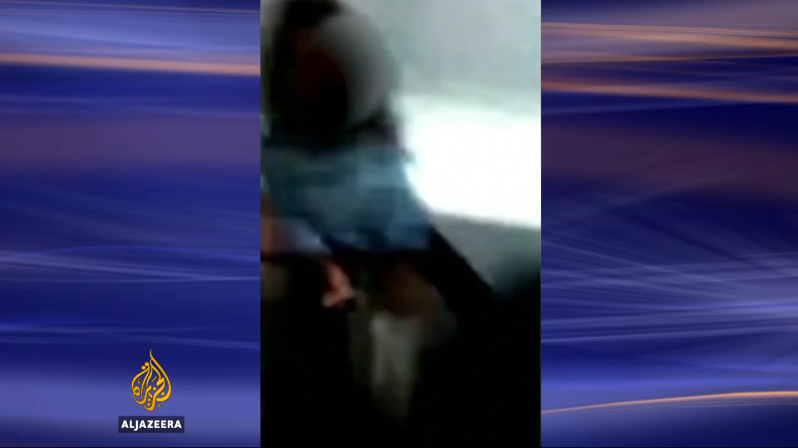
Chicago Torture

Slide 25
YOU DECIDE:
ARE THE FOLLOWING CRIMES HATE CRIMES?
Overnight, unknown persons broke into a synagogue and destroyed several religious objects. The offenders drew a large swastika on the door and wrote “Death to Jews” on a wall. Although valuable items were present, none were stolen. Hate Crime? Justify your answer.

Slide 26
You Decide:
Japanese-American was attacked by a white male wielding a tire iron. The victim suffered severe cuts and a broken arm. The incident took place in a parking lot next to a bar. Investigations revealed that the offender and victim had previously exchanged racial insults. Offender had initiated the exchange, using anti-Japanese slurs. He complained that Japanese were taking jobs from Americans. Hate Crime? Justify your answer

Slide 27
You Decide:
While driving through a predominately Hispanic neighborhood, a Black male stopped his car to repair a flat tire. A group of Hispanics leaving a bar across the street accosted the driver then attacked him with bottles and clubs. During the attack, the offenders used racial slurs and told him Blacks were not welcomed in the neighborhood. Hate Crime? Justify your answer.

Slide 28
You Decide:
A group home for persons with psychiatric disabilities was the site of a reported arson. Apparently, neighbors had expressed many concerns about the group home and were angry that the house was located in their community. Shortly before the fire was reported, a witness heard a young man state, “I’ll get rid of those crazies.” “I’ll burn them out.” Hate Crime? If so, what group? Justify your answer.

Slide 29
You Decide:
An adult white male was approached by four white teenagers who requested money for the bus. When he refused, one of the youths said to the others, “Let’s teach this (bad word for a gay person) a lesson.” The victim was punched in the face, knocked to the ground, kicked several times and robbed of his wristwatch, ring, and wallet. When he reported the crime, the victim advised he did not know the offenders and he was not gay. Hate Crime? Justify your answer

Slide 30
You Decide:
On a Saturday morning a man is standing at the corner of a busy intersection near a synagogue. He is saying offensive things such as “All Jews should die” and “Hitler didn’t finish the job.” He is also distributing anti-Semitic hate literature and is a member of a neo-Nazi group, What Crime? Hate Crime? Justify your Answer.

Slide 31
You Decide:
Students at a religious school vandalized their own school, leaving anti-religious statements on the walls. Nothing is taken. Hate Crime? What is the motivation? Justify your answer.

Slide 32
You Decide:
A white male and a black male in a bar argue about a game. They begin fighting and during the fight use numerous racial slurs against each other. You arrive and witnesses advise you of this. Hate Crime? Justify your answer.

Slide 33
You Decide:
Two young males have a scam going. They get into a car, cover the license plate with a t-shirt, and look for victims. When they see an elderly female (70’s/80’s) one jumps out of the passenger seat, runs over to her, knocks her down and steals her purse. When caught they’re asked why did they target older women (if over the age of 60, a person can be a victim of a hate crime), they said because they’re easy targets. We may have a double victim here: Gender and Age. Hate Crime?

Slide 34
You Decide:
Each April, Indian groups from all over North America have a Gathering of Nations in Albuquerque. A Native American band performed during the noon hour at the University of New Mexico. At the library nearby, a white male couldn’t study because of the music. He went up to the band, pulled the plug and shouted, “You’re a bunch of monkeys! That’s why they put you on the reservation!” and stormed off. Hate Crime? Justify your answer.

Slide 35
You Decide:
Las Vegas, New Mexico. A local Hispanic often would go to a bar popular with Mexican nationals. One afternoon, he got into a fight with a Mexican national and was evicted. He came back with his vehicle and ran over a Mexican National. He was heard saying bad things about Mexican Nationals. Hate Crime? Justify your answer.

Slide 36
IF YOU SUSPECT A CRIME MOTIVATED BY HATE:
Notify the field supervisor and /or unit commander as soon as possible. Command level officers also need to be notified.
Police department should notify the District Attorney as soon as possible.
Most common mistakes when a hate crime occurs
Misidentification whether a hate crime occurred or not.
Treating a hate crime like any other crime.

Slide 37
ROLE OF POLICE – PREVENTION AND BEING PROACTIVE
When is the most appropriate time to look into hate crimes?
Treat every hate crime seriously.
The most common hate crimes are misdemeanors: graffiti and vandalism.
Don’t ignore – could escalate into more serious crimes including homicide

Slide 38
TYPES OF PEOPLE WHO COMMIT HATE CRIMES
Hate gangs or hate groups
White supremesist groups are most recognizable.
  Promote intolerance
  Vocal
  Existing racial/religious tensions increased
  What should law enforcement do when there is a hate gang or hate group in the community?
    RESPECT & Monitor

Slide 39
TYPES OF PEOPLE WHO COMMIT HATE CRIMES
Majority are individuals
May or may not belong to hate group
Follow similar ideology
  Thrill Seekers (mostly vandals= youth + alcohol)
  People w/a mission (strong duty to push ideas)
    Think they are saving the world
    People experiencing negative change
      Mexicans are stealing our jobs
    Conflicted Offenders (Native vs. “half breed”)

Slide 40
ROLE OF POLICING – WORKING WITH THE VICTIM
Victims are emotionally & psychologically traumatized
Emotions are high, perhaps higher than normal
Must demonstrate high level of compassion and empathy
Failure to communicate frequently with the victim may increase their sense of isolation.
Need to let the victim know quickly that the agency takes such crimes very seriously.
Need to reassure victims that every investigative procedure is being utilized to solve the crime
Offer support beyond they investigative stage i.e. counseling services, advocate, ombudsmen.

Slide 41
ROLE OF POLICING – WORKING WITH THE COMMUNITY
Hate crimes are high profile. Need to work closely with targeted group
Direct threat to stability of the community
  All members of targeted group feel victimized
  Retaliation possible
  Escalation beyond control possible
Improperly handling a hate crime can cause groups to ignite in protest

Slide 42
ROLE OF POLICE – WORKING WITH THE NEWS MEDIA
The news media wants a story
  They will make one up if you don’t give them yours
  Follow agency protocol
  Chief or PIO
The media can serve as a catalyst to explosive riots

Slide 43
ROLE OF POLICE- WORKING WITH THE COURTS
Because of the potential for retaliation and the emotionally charged environment
Because of the public and media interest
Officers must work with court staff and judges to ensure order is kept.

Slide 44
HATE CRIMES IN NEW MEXICO
News Item: Hate Crime Case Ends: 6 Sentenced in Gay Beating
The victim said that, “being beaten solely because of my lifestyle is hard to accept. I will never forget this.”
The Judge said, “I think both of you need to see the inside of a Penitentiary. I can’t let the community think this is acceptable behavior.” Albuquerque Journal, April 6, 2006.
News Item: Guilty Pleas in Beating of Gay: Lawyer says Juvenile won’t contest charges
The only juvenile among a group of six males charged with beating a gay man in Santa Fe will plead “straight up” guilty to all charges, his attorney said. Albuquerque Journal, August 5, 2005.

Slide 45
HATE CRIMES IN NEW MEXICO
News Item: Edgewood Teens Punished in Beating of Gay Man
A Santa Fe teen who blindfolded a gay Edgewood man and participated when a group tried to “beat him straight” was sentenced to a year in jail. “To beat him because he was gay, so he would become straight, the hatred of that is frightening,” District Court Judge Michael Vigil said to offender Cecily Gonzales, 17, as she wept. Vigil also handed down a sentence for co-defendant Uriah Smith, 18. Smith was sentenced to four years in prison. Albuquerque Journal, April 13, 2007.

Slide 46
HATE CRIMES IN NEW MEXICO
News Item: Hate Crimes in Farmington
Two white men who were charged with beating up and robbing a Navajo man were sentenced. There was no proof of hate crime for the 21-year-old and he was given three years. But it was a different story for the nineteen year old who admitted he was motivated by hate. He was found guilty of violating the Hate Crimes Act. He was sentenced to seven years at the State Penitentiary. Albuquerque Journal, April 18, 2007 and July 19, 2007.

Slide 47
THE FUTURE OF HATE CRIMES
Crimes motivated by hatred will continue to be part of our society.
Need to be vigilant when it comes to hate crimes every increasing.
Depending on current social and political climate, the occurrence of hate crimes rise and fall.
Increase or decrease under the Obama administration?
Increase or decrease under the Trump administration?

Slide 48
THE FUTURE OF HATE CRIMES
Practices for officers/agencies and hate crimes:
  Establish written policy
  Project empathy and respect
  Take your investigation seriously, hate crimes should have certain level of priority
  Document in great detail the evidence contributing to hate crimes designation
  Communicate frequently with victims
  Communicate with DA’s office
  Communicate with media
  Communicate with other jurisdictions

Slide 49
CONCLUSION
We have learned about the hate crimes statute, how to recognize hate crimes and how we, as officers should to respond to it. Regardless the frequency with which they occur, we need to react quickly and take them seriously.

